Slide 1

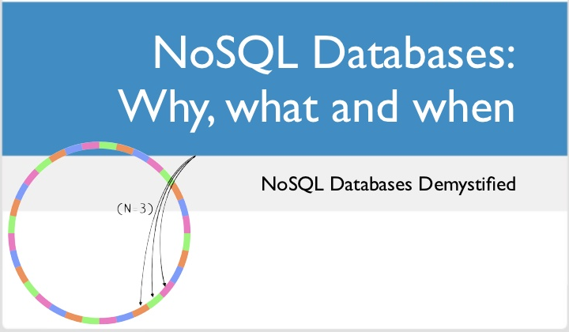
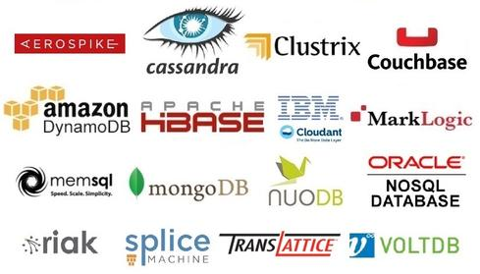
© ggk technologies

Slide 2

Agenda
SMP Vs MPP Systems
Not Only SQL (NoSQL) introduction
MongoDB
Neo4j
Cassandra
MarkLogic
NoSQL Database Comparisons
Polyglot Persistence
© ggk technologies

Slide 3
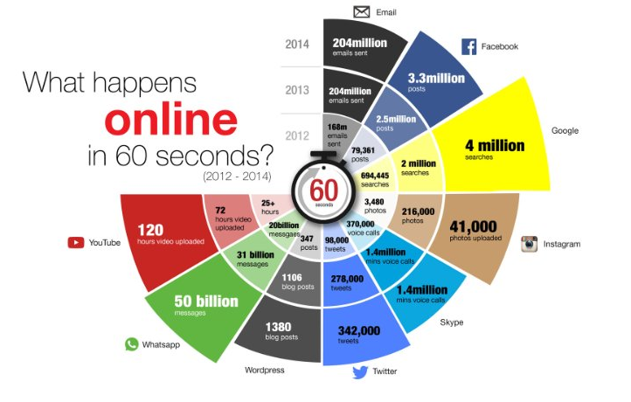
© ggk technologies

Slide 4

Challenges with traditional RDBMS (SMP) Systems
© ggk technologies

Slide 5
Challenges with traditional RDBMS (SMP) Systems
Limited Scalability
Handling High Data Volumes and Data Growth
Longer transaction/load times due to Limited I/O
Long query execution times with growing data volumes
© ggk technologies
Notes:
Add the available options and then discuss why we go to MPP systems. (Oracle Hexadata, Teradata, Greenplum)

Slide 6

Challenges with traditional RDBMS (SMP) Systems
SMP Systems
MPP Systems
© ggk technologies

Slide 7
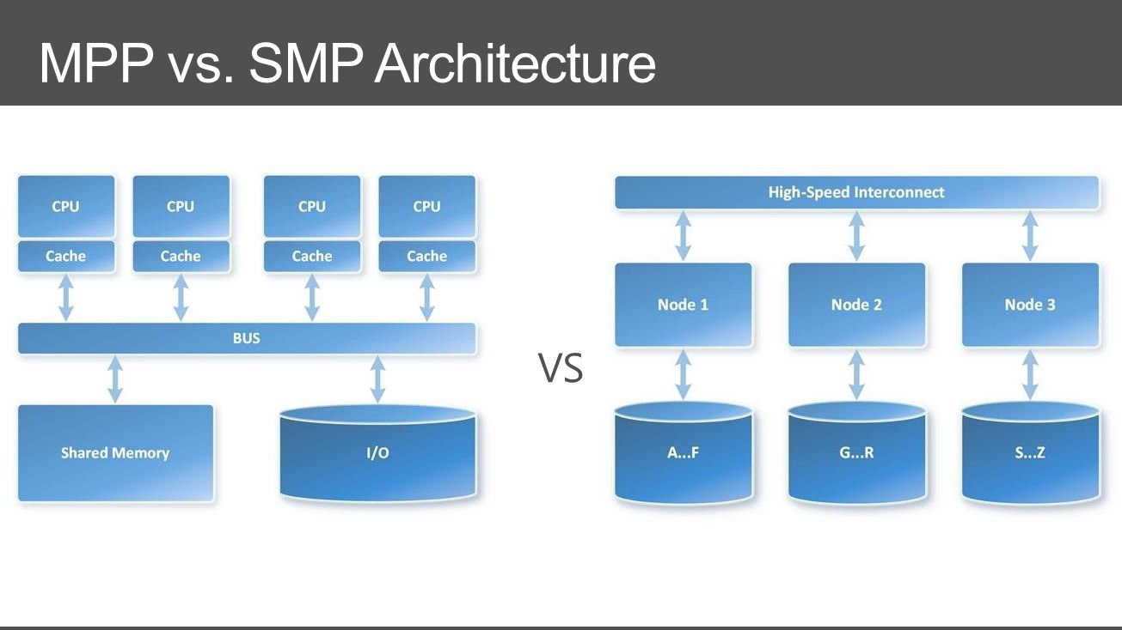
SMP vs MPP Architecture
SMP (Symmetric multi Processing systems)
MPP (Massively Parallel Processing systems)
© ggk technologies
Notes:
SMP - Tightly coupled processors that share resources like operating system, memory, disk, I/O etc. Can only be scaled up until a certain limit. Not able to handle huge data.
MPP - Shared nothing or shared disk architecture. Each Node can work independently of the other nodes. No bottleneck at a single point. Can easily be scaled out for larger data sets.

Slide 8
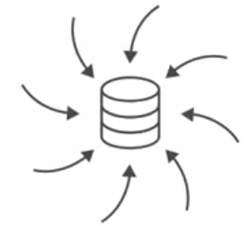
Factors Driving Modern Applications
Mobile
Mobile now > 50% internet use
26 Billion devices on IoT by 2020
Data
90% data created in last 5 years
80% enterprise data is unstructured
Unstructured data growing 2X rate of structured data
Social
72% of internet use is social media
2 Billion active users monthly
93% of businesses use social media
Unpredictability -> Cloud
On the fly Scalability
Storage costs declining 38% YOY
Compute costs declining 33% YOY
Network costs declining 27% YOY
© ggk technologies
Notes:
Cloud - Unpredictable usages - On Demand computing costs. (Eg: Flipkart Big Billion day)

Slide 9

© ggk technologies

Slide 10
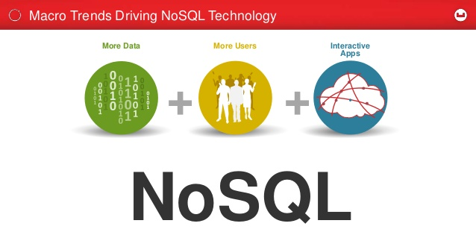
Why NoSQL?
Schema less
High scalability
High availability
Inbuilt native APIs
© ggk technologies
Notes:
Interactive time - More tables in a single query.
Json format and decrease requests

Slide 11
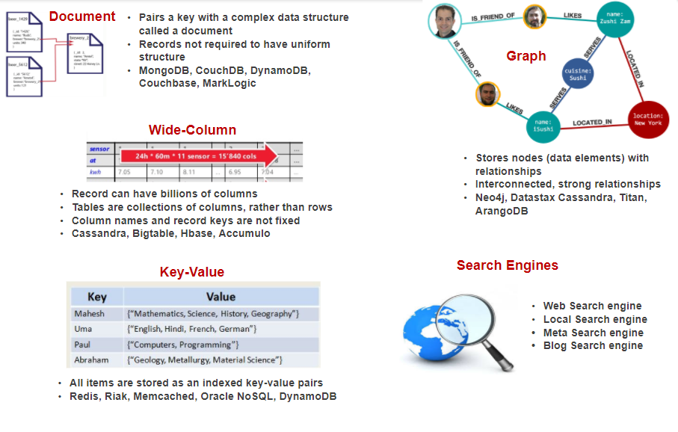
NoSQL Database - Storage Architecture
. Neo4j, ArangoDB, AllegroGraph
© ggk technologies
Notes:
Document Store Databases:
Supports storing unstructured data unlike relational databases.
Improved query performance by having denormalized data
Can easily handle Thousands of transactions per second
Easily scalable
Key-Value databases:
Provides high speed access to data using key value pairs for storing the data. Uses Associative arrays, dictionaries and hash types to store the data
Usually used to implement caching.
Graph databases:
Used to store semantic and hierarchical data. Complex hierarchical queries can be easily executed against these databases.
Data is usually modeled as Nodes and relationships between these nodes.
Columnar databases
Stores complete data in the form columns. Provides faster access to specific elements in the data.
Reduces disk reads by reading only the specific columns that are required to process the query
https://biauthority.files.wordpress.com/2013/01/image020.jpg
Database Land space
Hierarchical structures
Denormalized, heavily redundant
Cannot be used for volatile datasets
Only act on Limited datasets (Graph)

Slide 12
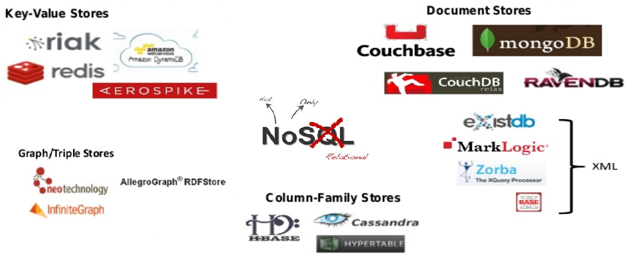
The NoSQL Universe
© ggk technologies

Slide 13



© ggk technologies

Slide 14


Slide 15
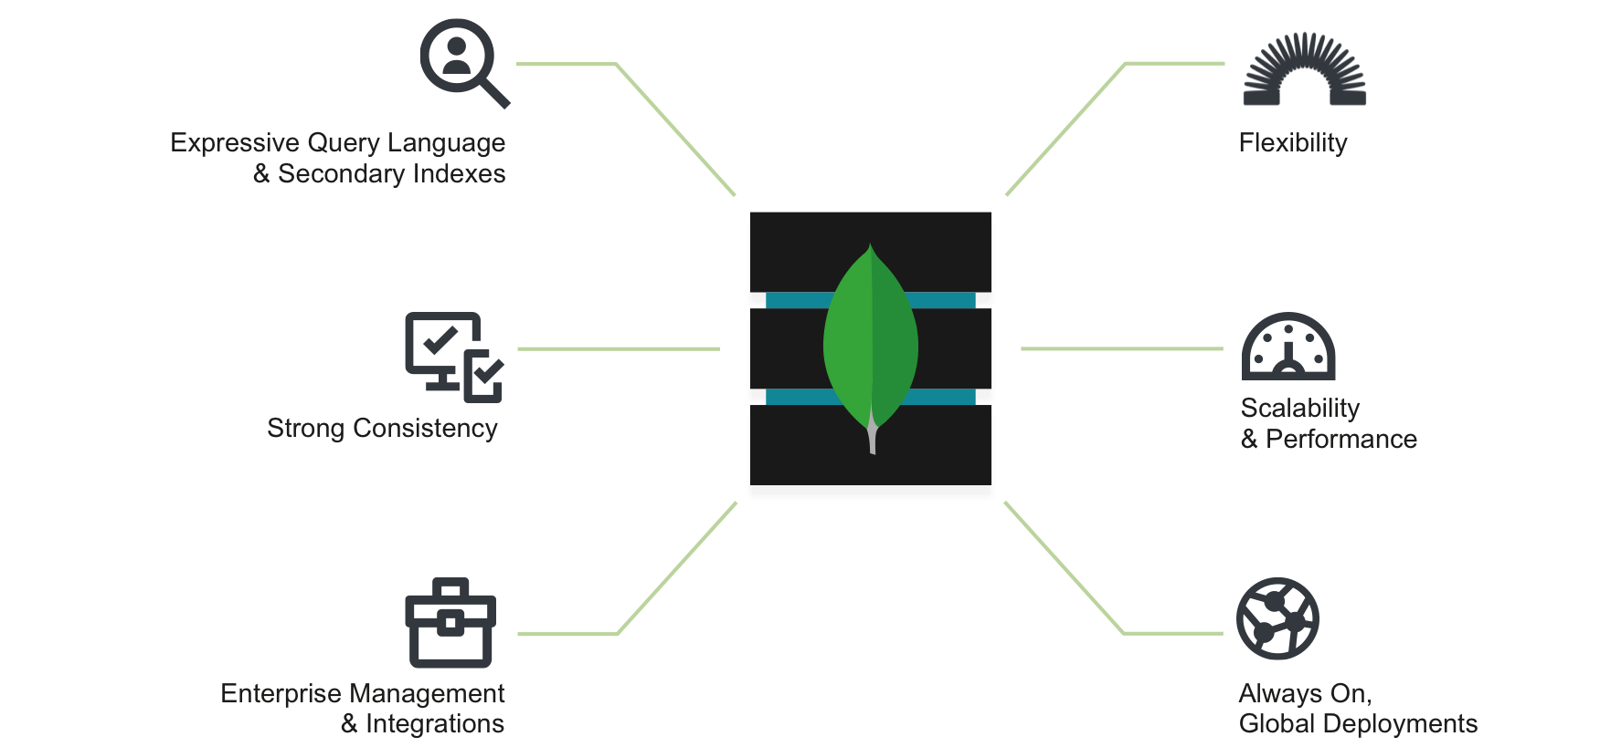
Why MongoDB?
Document Model
Dynamic Schema
Powerful Query Language
Secondary Indexes
© ggk technologies
Notes:
Let us discuss more MongoDB which is a typical Document store Database which shows data as JSON document
Everyone Loves MongoDB’s Flexibility • Document Model • Dynamic Schema • Powerful Query Language • Secondary Indexes

Slide 16


Everyone Loves MongoDB’s Flexibility
Document Model
Dynamic Schema
Powerful Query Language
Secondary Indexes
© ggk technologies
Notes:
Everyone Loves MongoDB’s Flexibility • Document Model • Dynamic Schema • Powerful Query Language • Secondary Indexes. And that is the reason we could see its usage increased a lot in the Market

Slide 17

MongoDB
Quick MongoDB Introduction
Architecture (Read/Write Flow)
Data Modelling
Sharding
Best Practices
Hardware/OS
Schema/Queries
Loading Data
© ggk technologies

Slide 18
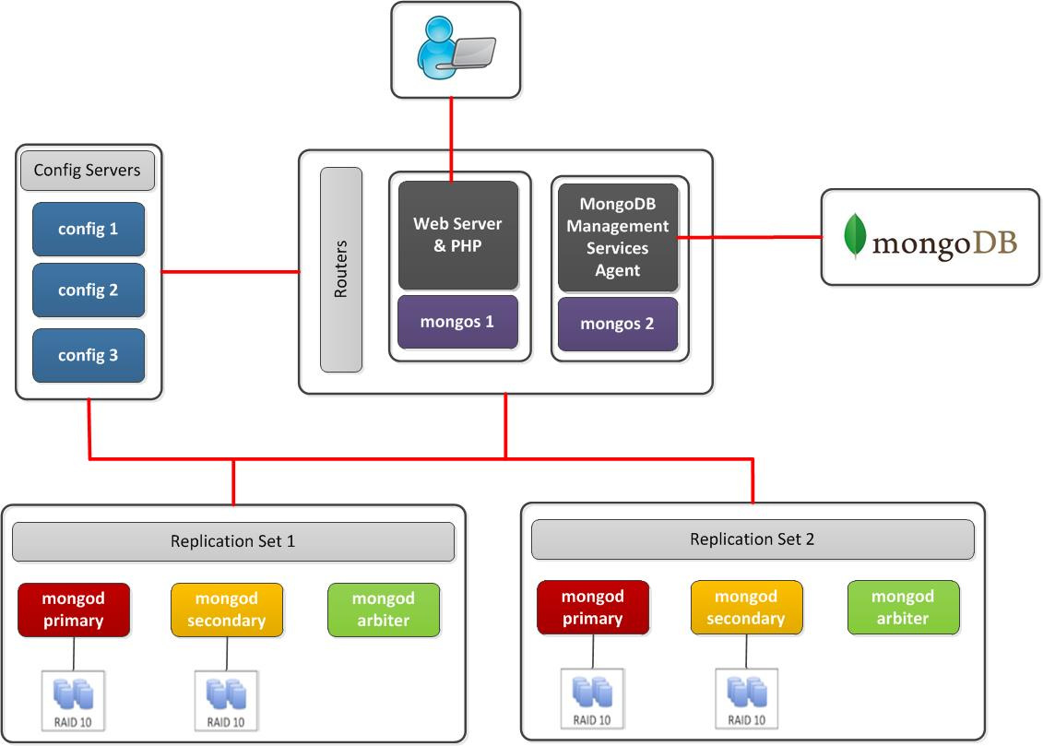
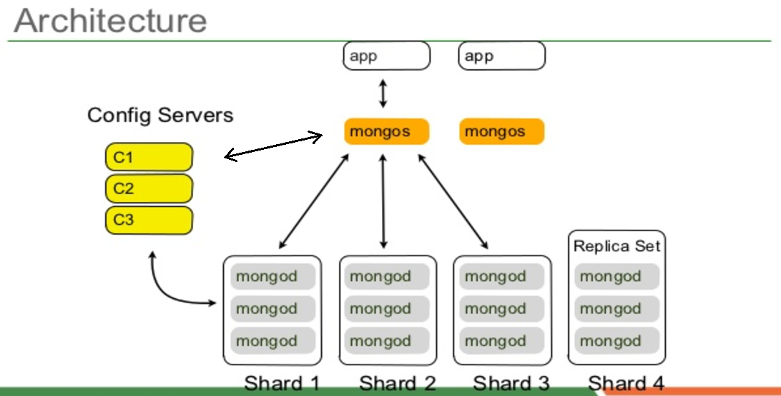
MongoDB Cluster
© ggk technologies
Notes:
We will have Applications connected to specific Mongos(which are actual query routers). These Query routers are medium to distribute the load of the Query by fetching the information from the Config Servers. Mongos route the query to specific shard (node) and fetch the data from individual node which again do an aggregation/sort if necessary.

Slide 19
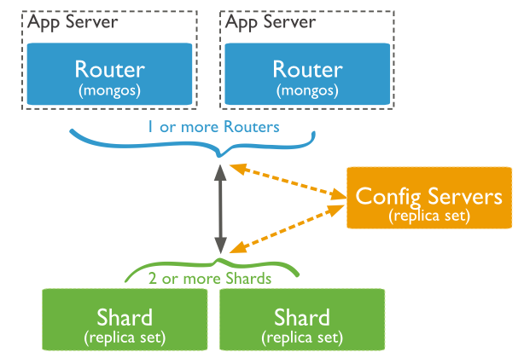
Architecture Components
MongoDB cluster have these main components:
Shards/mongod stores data. To provide high availability and data consistency in a production sharded cluster, each shard is a replica set.
Query Routers/mongos instances, will interface with client applications and direct operations to the appropriate shard or shards. A client send requests to a mongos, which then routes operations to the shards and returns results to the clients. A sharded cluster can contain more than one mongos to divide client request load and most sharded clusters have more than one mongos for this reason.
Config servers store cluster’s metadata. This data contains a mapping
of the cluster’s data set to the shards. The query router uses this metadata
to target operations to specific shards.
© ggk technologies

Slide 20
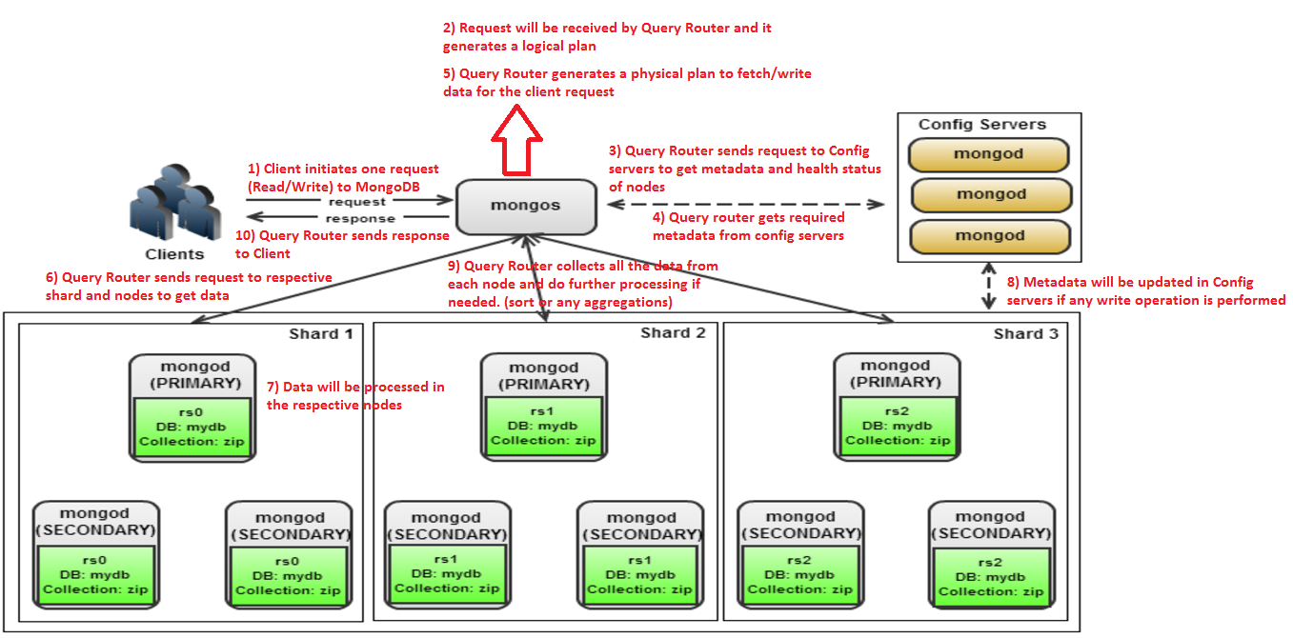
Write/Read data flow in MongoDB
© ggk technologies

Slide 21
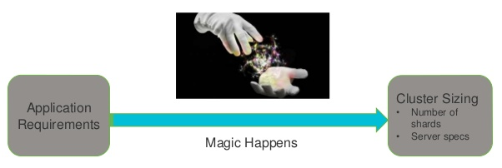

Cluster Setup
Magics won’t happen in real world
We need to follow best practices to form a MongoDB cluster with best performance
© ggk technologies
Notes:
Magic won’t happen in real world. But YES!!! You can make things to work MAGICALLY by following best practices!! As an Application user or Application architect everyone thinks that once the cluster setup is done we can have everything in place and no need to worry at all. Yes, but that will only happen when we configure our cluster properly. Moving forward we will explain you what are the key points we need to consider before configuring a cluster.

Slide 22


Slide 23

Servers
Specifications Good Fit For MongoDB?
Correct Number of Servers?
Properly Configured?
© ggk technologies
Notes:
Servers • Specifications Good Fit For MongoDB? • Correct Number of Servers? • Properly Configured?

Slide 24


What Type of Servers?
RAM
64 256 GB+
Fast IO Systems
RAID-10/SSDs
Many cores
Compress/Uncompress
Encrypt/Decrypt
Aggregation queries
© ggk technologies

Slide 25
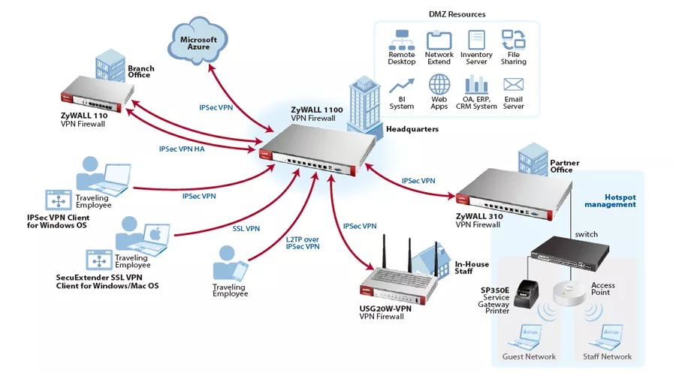
Prerequisites (Load calculations)
Be aware of the following things before forming a cluster
# of documents to fetch per second
# of documents updated per second
# of indexes impacted by each update
# of inserts per second
# of indexes impacted by each insert
# of deletes per second (x2)
# of indexes impacted by each delete
Multiple updates occurring within checkpoint
% of find query results in cache
© ggk technologies
Notes:
Once we decide on each server configuration we need to see the prerequisites of the cluster.

Slide 26


How Many Servers Do I Need?
© ggk technologies
Notes:
Here comes important part. How Many Servers Do I Need?

Slide 27

MongoDB Cluster Sizing
Disk Space
RAM
Query Throughput
© ggk technologies
Notes:
Designing of MongoDB cluster considering the Disk Space and RAM selected and being cautions on Query Throughput

Slide 28
Disk Space: How Many Nodes Do I Need?
Sum of disk space across nodes > greater than required storage size
© ggk technologies
Notes:
Sum of disk space across nodes > greater than required storage size Disk Space: How Many Nodes Do I Need?

Slide 29
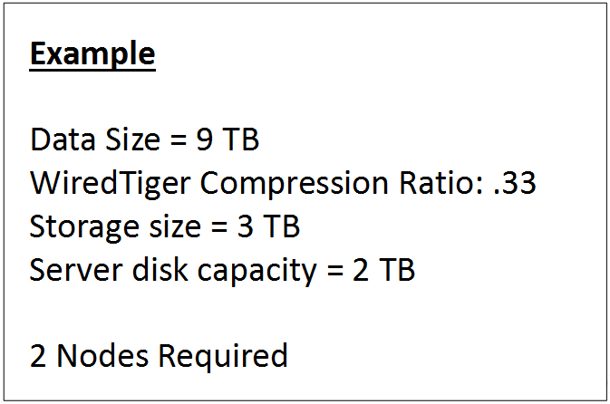
Disk Space: How Many Nodes Do I Need?
Sum of disk space across nodes > greater than required storage size
© ggk technologies
Notes:
Considering the regular and minimal compression ratio. If we see the general statistics.

Slide 30
RAM: How Many Nodes Do I Need?
Working set should fit in RAM
Sum of RAM across nodes > Working Set
WorkSet = Indexes plus the set of documents accessed frequently
WorkSet in RAM
Shorter latency
Higher Throughput
© ggk technologies

Slide 31
RAM: How Many Nodes Do I Need?
Measuring Index Size
db.coll.stats() – index size of collection
Estimate frequently accessed documents
Ex: total size of documents accessed per day
© ggk technologies

Slide 32
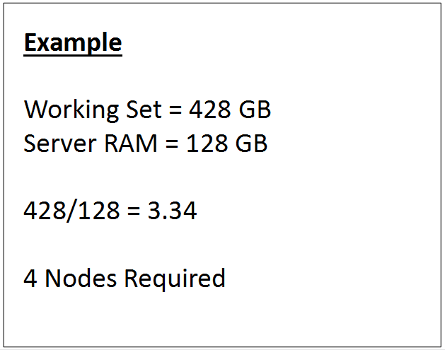
RAM: How Many Nodes Do I Need?
Measuring Index Size
db.coll.stats() – index size of collection
Estimate frequently accessed documents
Ex: total size of documents accessed per day
© ggk technologies

Slide 33
Query Rate: How Many Nodes Do I Need?
Measure max sustained query rate of a single server (with replication)
Build a prototype and measure
Assume node overhead of 20-30%
© ggk technologies

Slide 34
Query Rate: How Many Nodes Do I Need?
Measure max sustained query rate of a single server (with replication)
Build a prototype and measure
Assume node overhead of 20-30%
Example
Require : 50k ops/sec
Prototype performance : 20k ops/sec (1 replica set)
20k ops/sec * 0.7 = 14
50 / 14 = 3.57
4 nodes required :
(4* 20k ops/sec) * 0.7 = 56k ops/sec
© ggk technologies

Slide 35
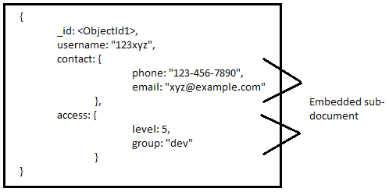
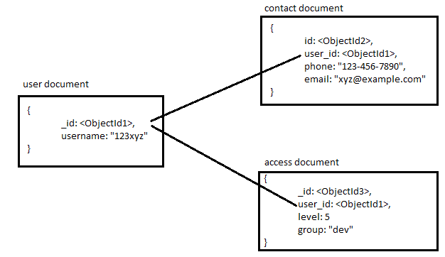
Data Modelling
Embedded Data Model : (Denormalized) Normalized Data Model :
© ggk technologies
Notes:
We are habituated to normalize the data into many tables to reduce the data redundancy. We started living like a frog in a well following the existing standards and regular way of data modelling. We never thought about why we are joining 3 or 4 table in completing a single transaction?? Why can’t we build our data model transaction specific? Almost all the NOSQL databases follow the above questions and build Denormalized data modelling. We call them as Embedded Data model. Selecting the important columns which are specific to the transaction and embedding them into a single collection keeping the main table as a reference or Master.

Slide 36

Data Models in MongoDB
MongoDB is mostly suitable for Denormalized Data Model which
is also called as Embedded Data Model. This Denormalized Data
Model is broadly classified into 2 types which are listed below :
Embedded Document Data Model
Reference Document Data Model
Embedded Document Data Model is placing an entire document as a field in another document. This data model is mostly when we have one-one or one-two, maximum upto 5 documents. Because if the documents which are embedded increases , then the entire document size will increase which creates some burden on the system.
Reference Document Data Model is similar to Foreign Key relation in SQL. This data model is mostly useful when we have one-many relationships.
© ggk technologies

Slide 37
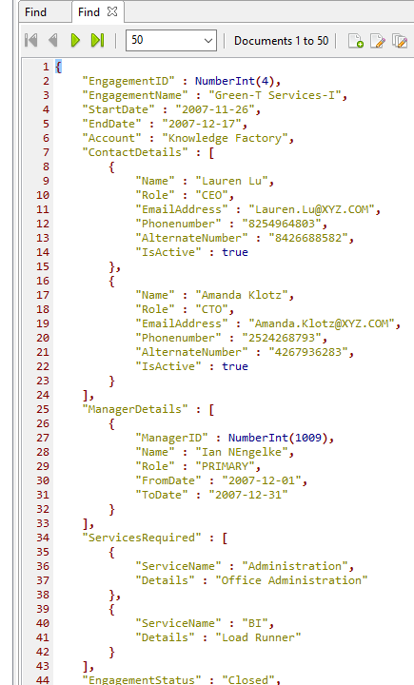
Embedded Document Data Model
In Embedded Document Data Model, we will embed group of child documents inside a parent document.
This approach maintains all the relative data in a single document, which makes it easy to retrieve and maintain. The whole document can be retrieved in a single query.
© ggk technologies

Slide 38
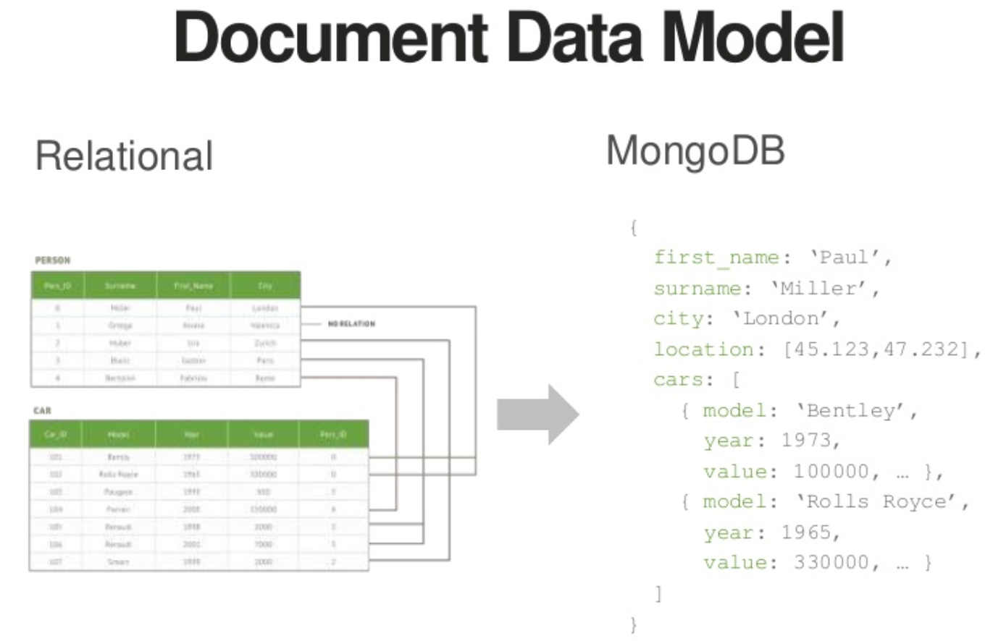
© ggk technologies
Notes:
In relation modelling we will have id values in one table(names) and will maintain foreign key relation with the other table (Cars) and maintain necessary information in other table. In Embedded modelling will keep all the information in a single collection. If there is a requirement like a person has more than one cars, we will maintain a embedded document as an array field and keep 2 or more cars information related to him in a single document

Slide 39
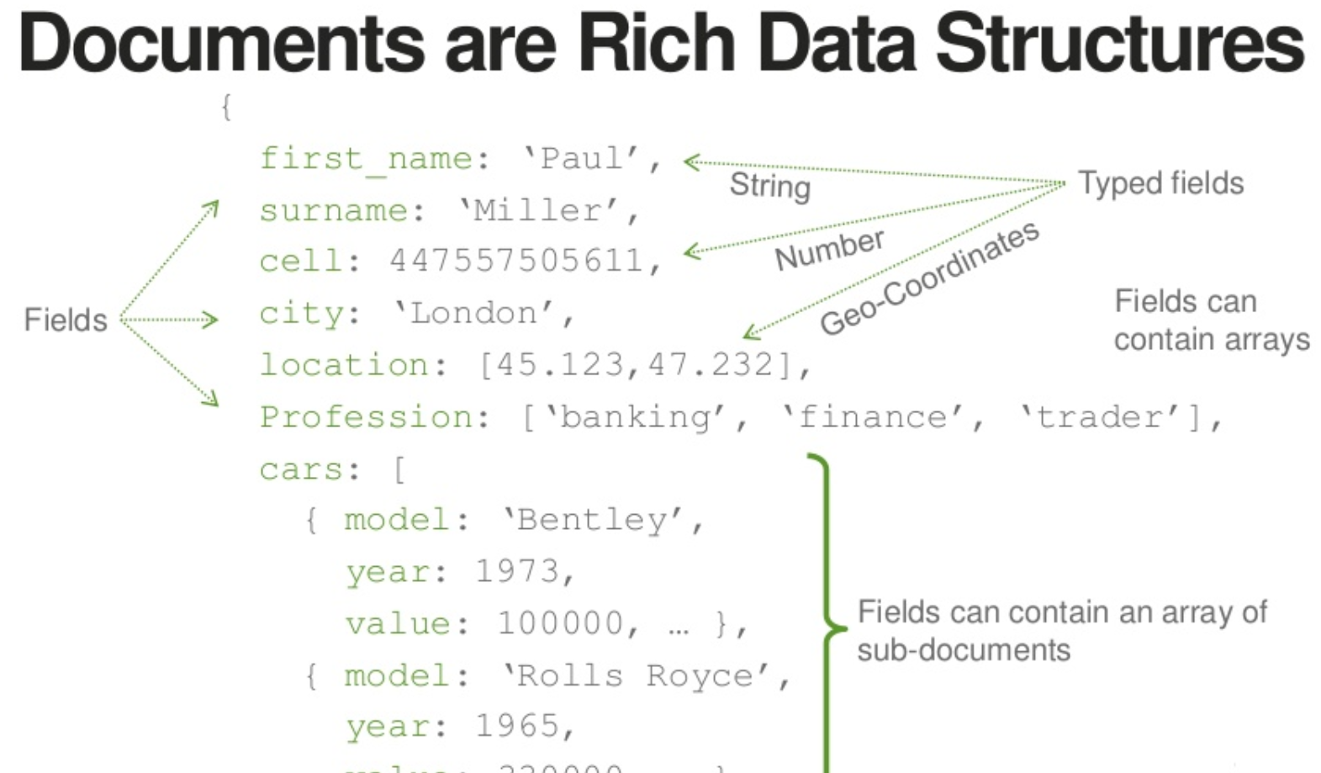
© ggk technologies
Notes:
Can maintain all the necessary data types needed.

Slide 40
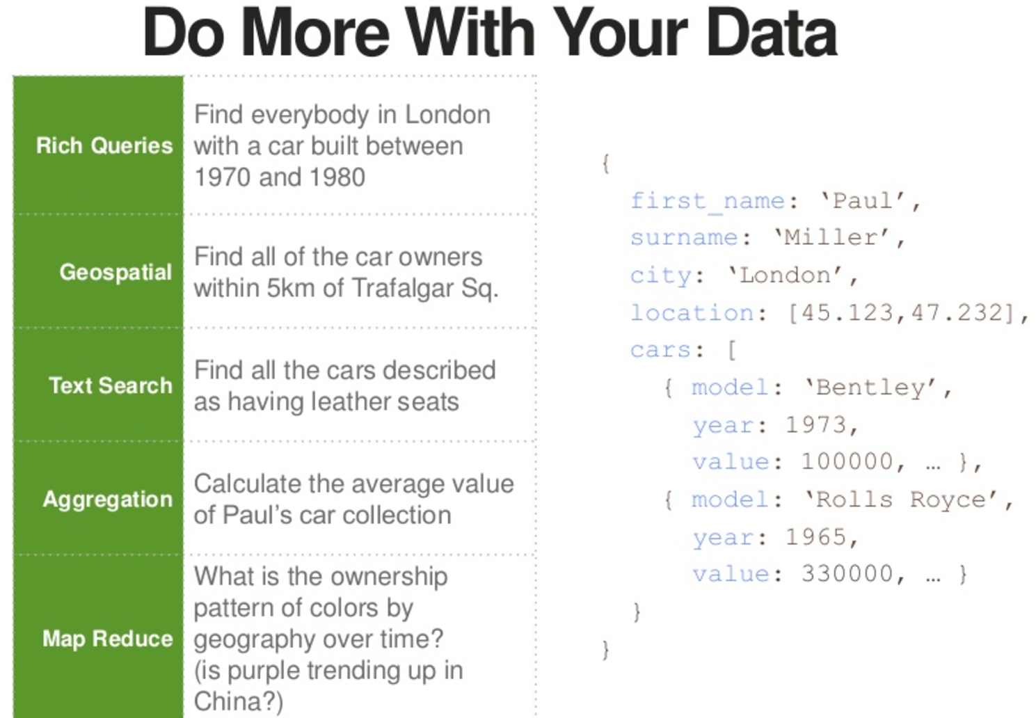
© ggk technologies

Slide 41
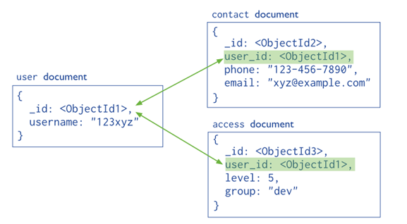
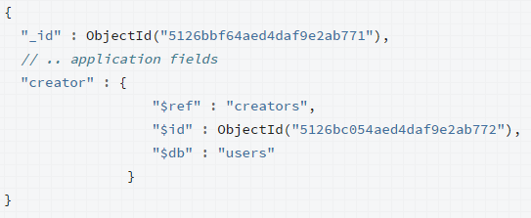
Reference Document Data Model
MongoDB application use one of two methods for relating documents:
Manual references where you save the _id field of one document in another
document as a reference. Then your application can run a second query to return the
related data. These references are simple and sufficient for most use cases.
DBRefs are references from one document to another using the value of the
first document’s _id field, collection name, and, optionally, its database name. By
including these names, DBRefs allow documents located in multiple collections to be
more easily linked with documents from a single collection.
© ggk technologies
Notes:
This type of modelling similar to foreign key relation but we can insert a document with an information which is not present in primary table. It is just kind of referring the other table data with an id column to join. However this is not a recommended every time

Slide 42
Modeling Decisions
Embedded Vs Reference
© ggk technologies

Slide 43
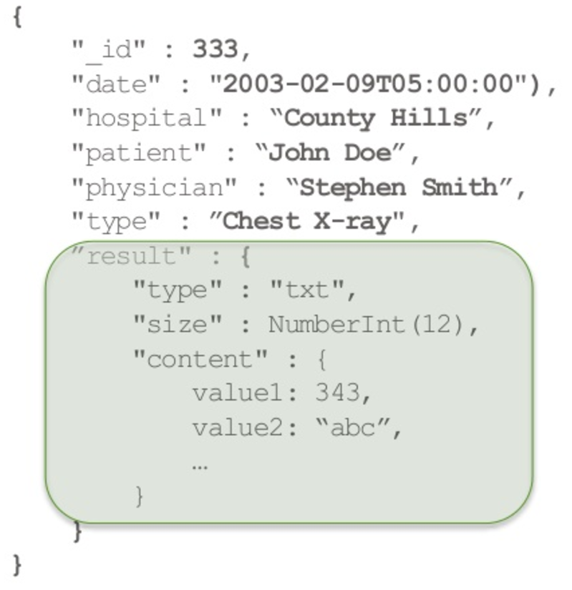
Embedded Data Model
Advantages
Retrieve all relevant information in a single query/document
Avoid implementing joins in application code
Update related information as a single atomic operation
MongoDB doesn’t offer multi-document transactions
Limitations
Large documents mean more overhead if most fields are not relevant
Might mean replicating data
16 MB document size limit
© ggk technologies

Slide 44
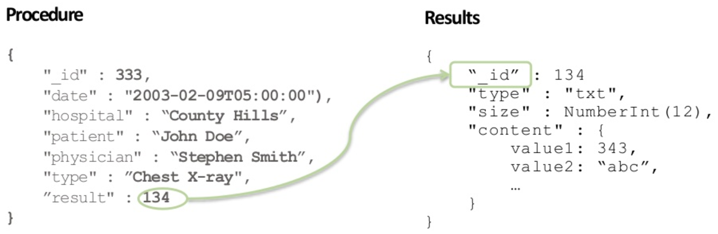
Referenced Data Model
Advantages
Smaller documents
Less likely to reach 16 MB document limit
Infrequently accessed information not accessed on every query
No duplication of data
Limitations
Two queries required to retrieve information
Cannot update related information atomically
© ggk technologies

Slide 45

Notes:
So are you now confused to adopt a specific Data modelling??

Slide 46

Notes:
We are here to suggest the Best practices for the Data modelling

Slide 47
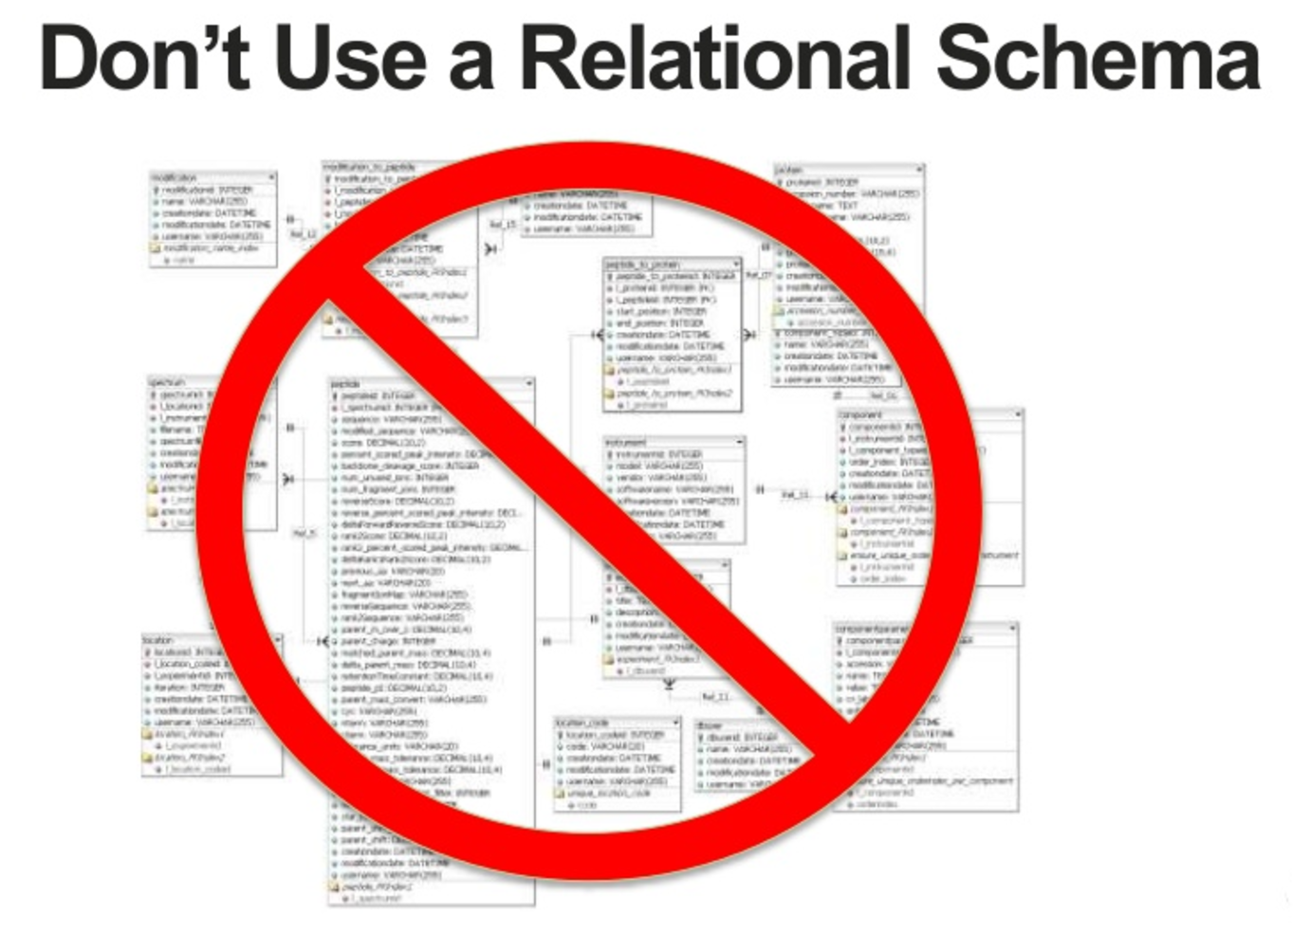
© ggk technologies
Notes:
Straight and simple do not go with Relation modelling approach Go with Embedding modelling considering the document size limitation 16mb and Transaction specific. Only essential columns are need to be added in Embedded documents. Go with Referential if all the columns are necessary and you are sure that if you add them as embedded may cross 16mb document limitation now or in near future

Slide 48
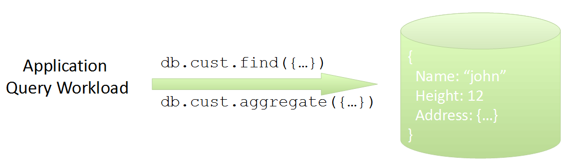
MongoDB Schema Design to
Application Workload
Design schema to provide good query performance
Schema design will impact required number of nodes!
© ggk technologies
Notes:
Apart from the above discussed points we even need to Query workload.

Slide 49

Vital Sign Monitoring Device
Vital Signs Measured:
Blood Pressure
Pulse
Blood Oxygen Levels
Produces data at regular intervals
Once per minute
© ggk technologies

Slide 50
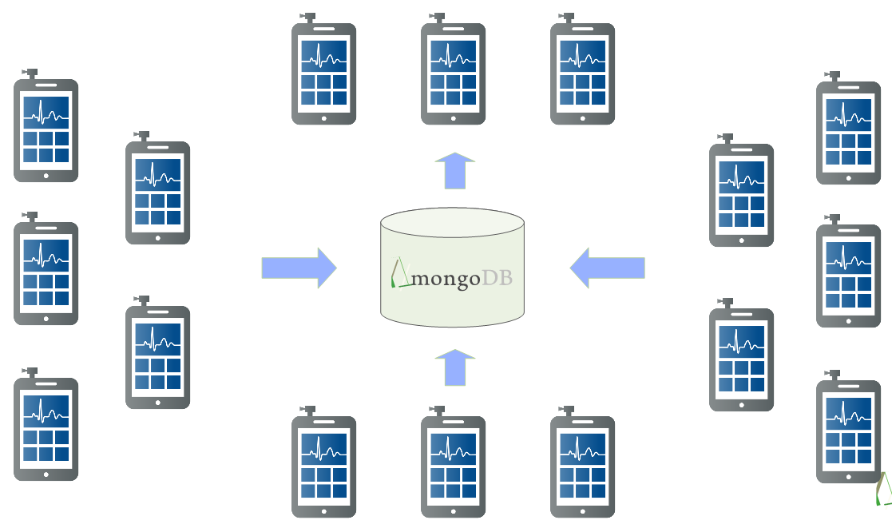
We have a hospital(s) of devices
© ggk technologies

Slide 51
Data From Vital Signs Monitoring Device
{
deviceId: 123456,
spO2: 88,
pulse: 74,
bp: [128, 80],
ts: ISODate("2013-10-16T22:07:00.000-0500")
}
One document per minute per device
Relational approach
© ggk technologies

Slide 52
Document Per Hour (By minute) Embedded
{
deviceId: 123456,
spO2: { 0: 88, 1: 90, …, 59: 92},
pulse: { 0: 74, 1: 76, …, 59: 72},
bp: { 0: [122, 80], 1: [126, 84], …, 59: [124, 78]},
ts: ISODate("2013-10-16T22:00:00.000-0500")
}
Store per-minute data at the hourly level
Update-driven workload
1 document per device per member per hour
© ggk technologies

Slide 53
Characterizing Write Differences
Example: data generated every minute
Recording the data for 1 patient for 1 hour:
Document Per Event
60 Inserts
Document Per Hour
1 Insert, 59 Updates
© ggk technologies

Slide 54
Characterizing Read Differences
Want to graph 24 hour of vital signs for a patient:
Read performance is greatly improved
Document Per Event
1440 Reads
Document Per Event
24 Reads
© ggk technologies

Slide 55
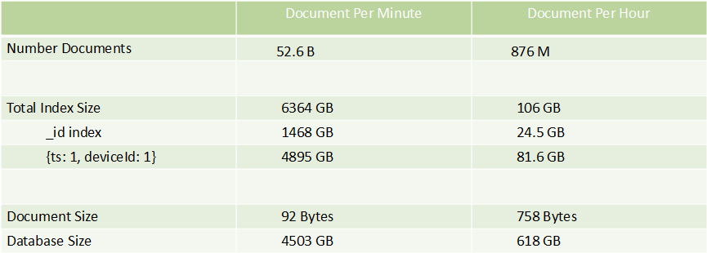
Characterizing Memory and Storage Differences
100K Devices
1 years worth of data
© ggk technologies

Slide 56
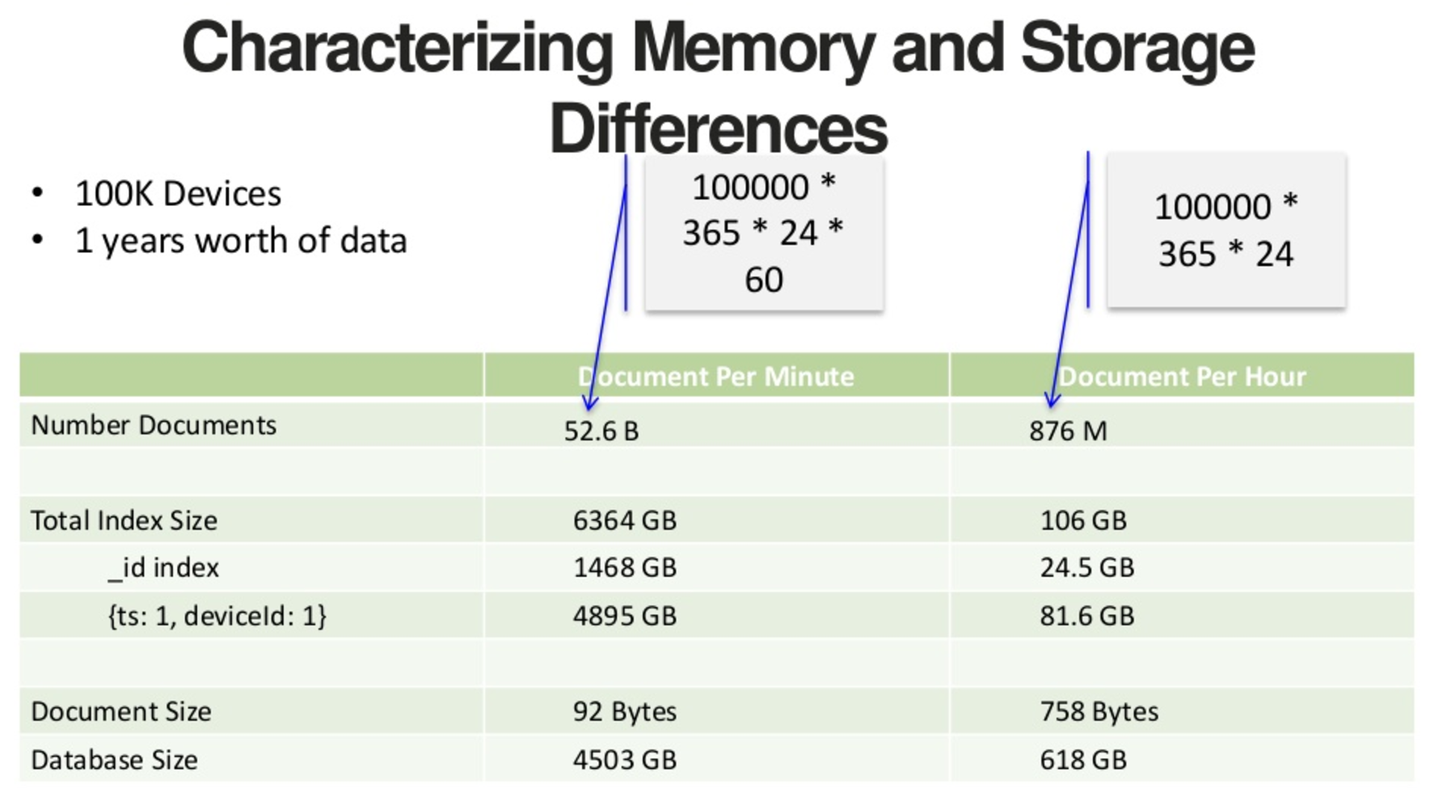
© ggk technologies

Slide 57
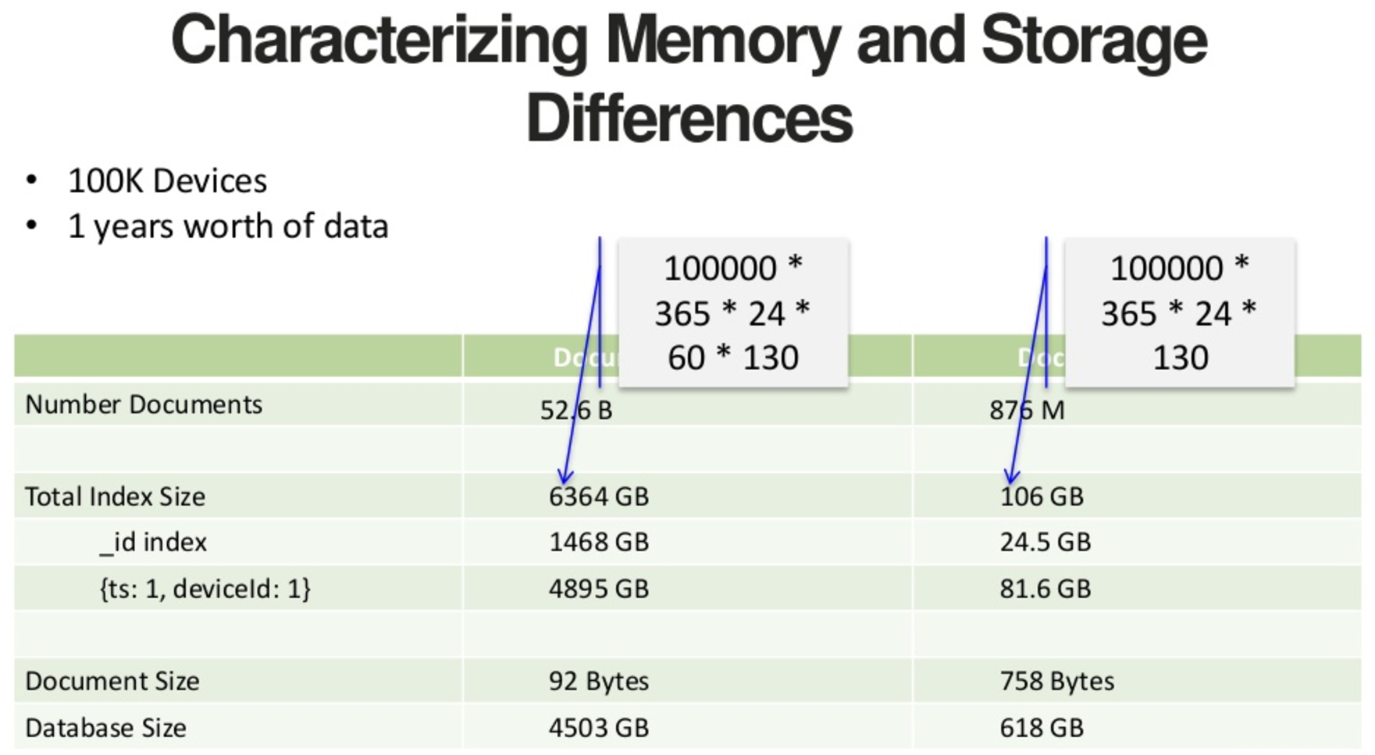
© ggk technologies

Slide 58
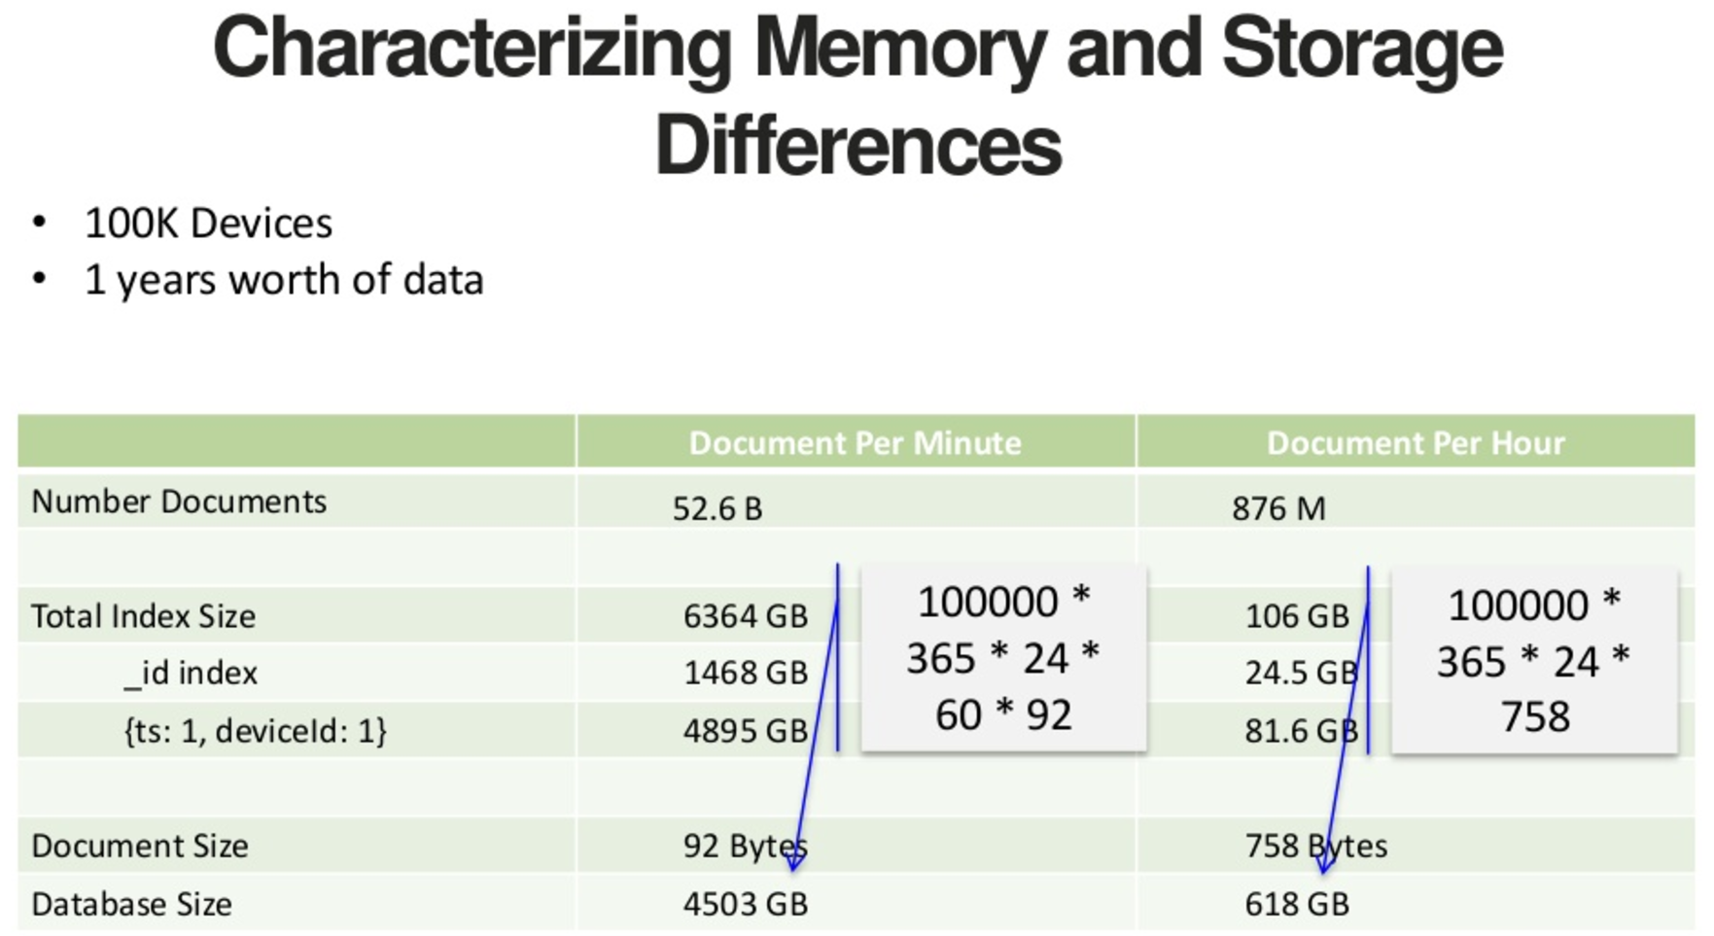
© ggk technologies

Slide 59
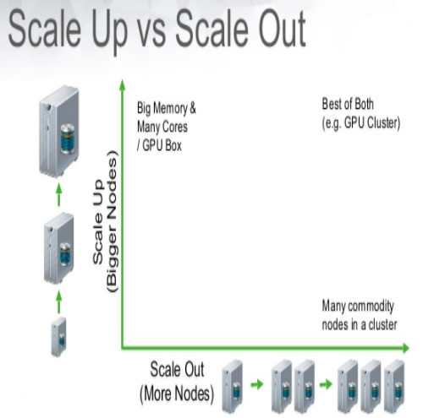
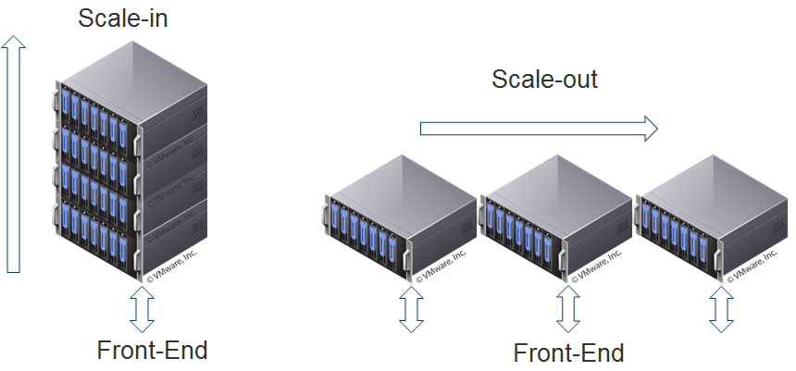
Scale-in Vs Scale-out
© ggk technologies

Slide 60
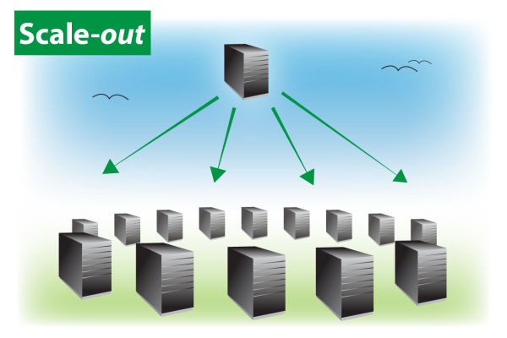
Be smart in choosing best Storage Architecture
Below points make most of the Database Architects to choose Scale-out Architecture instead of Scale-in :
Ability to increase computing potential at any time (By adding a node to cluster).
We can add or remove hardware based on customer requirement at any time.
Individual node failure will not harm our cluster.
Because of Replication mechanism we can achieve High availability.
Low cost commodity hardware can be used.
Possibility to scale both in capacity and in performance.
© ggk technologies

Slide 61
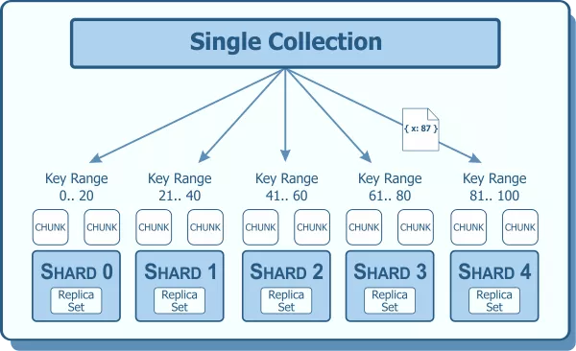
Sharding :
Sharding is a method of storing data across multiple machines. MongoDB uses sharding to support deployments with very large data sets and high throughput operations.
Purpose of Sharding :
Database systems with large data sets and high throughput applications can challenge the capacity of a single server
High query rates can exhaust the CPU capacity of the server
Larger data sets exceed the storage capacity of a single machine. Finally, working set sizes larger than the system’s RAM stress the I/O capacity of disk drives.
© ggk technologies

Slide 62
Data Partitioning :
MongoDB distributes data, or shards, at the collection level. Sharding partitions a collection’s data by the shard key.
Shard Key :
A shard key is either an indexed field or an indexed compound field that exists in every document in the collection. MongoDB divides the shard key values into chunks and distributes the chunks evenly across the shards.
To divide the shard key values into chunks, MongoDB uses either
range based partitioning or hash based partitioning
© ggk technologies

Slide 63
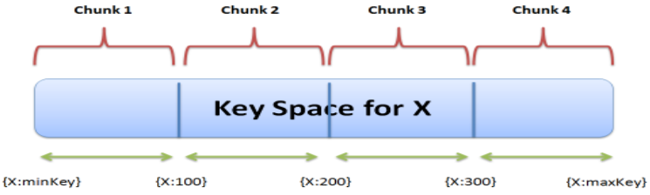
Range Based Sharding :
For range-based sharding, MongoDB divides the data set into ranges determined by the shard key values to provide range based partitioning.
MongoDB partitions the data into smaller, non-overlapping ranges called chunks where a chunk is range of values from some minimum value to some maximum value.
Syntax : sh.shardCollection( "database.collection", { <shard key> } )
© ggk technologies

Slide 64
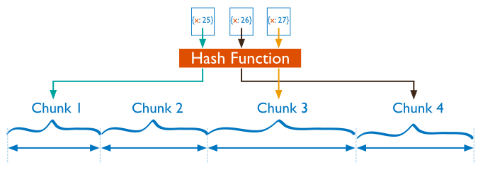
Hash Based Sharding :
For Hash based partitioning, MongoDB computes a Hash of a field’s Value, and then use these hashes to create chunks.
With Hash based partitioning, two documents with close shard key values are unlikely to be part of the same chunk. This ensures a more random distribution of a collection in the cluster.
Syntax : sh.shardCollection( "database.collection", { <field> : "hashed" } )
Warning : Adding/Removing a node requires data to be moved, which is costly.
© ggk technologies

Slide 65
What makes a good shard key?
The choice of shard key determines three important things:
Distribution of Reads and Writes (Cardinality)
Size of your Chunks
Number of Shards each query hits
© ggk technologies
Notes:
https://blog.bugsnag.com/mongo-shard-key/
Shard key is responsible for the distribution of the data.
Depends on the shard key the data is sorted and forms in chunks and these chunks are assigned to the Shards.
Now we need to see how many shards each query is hitting?

Slide 66
Good shard key schemes
Hashed _id
db.events.createIndex({_id: 'hashed'})
Multi-tenant compound index
db.events.createIndex({EmployeeId: 1, _id: 1})
Conclusion :
Choosing a shard key is hard, but there are really only two options :
If you can’t find a good grouping key for your application, hash “_id” field
If you can, then go with that grouping key and add the _id field to avoid jumbo chunks
© ggk technologies
Notes:
https://blog.bugsnag.com/mongo-shard-key/

Slide 67
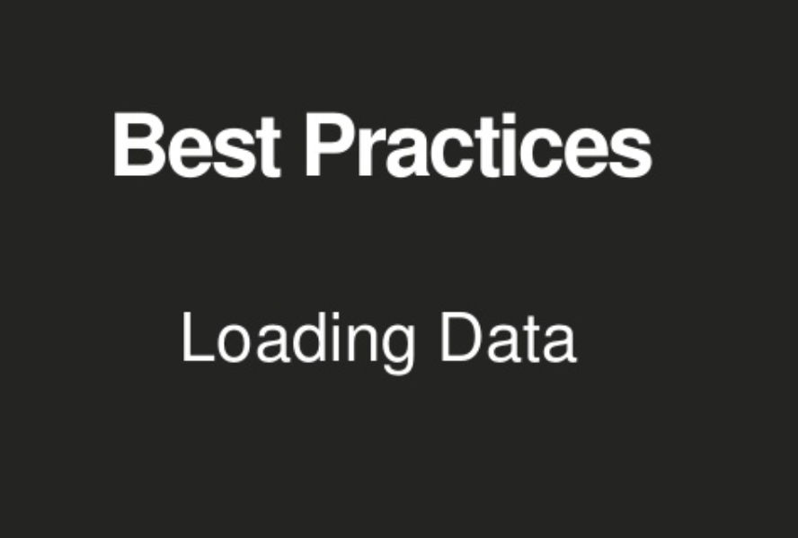

Slide 68
Rule of Thumb
To saturate a MongoDB cluster
loader hardware ~= mongodb hardware
Many threads
Many mongos
© ggk technologies
Notes:
It is better to maintain as equal number of Loaders as servers.

Slide 69
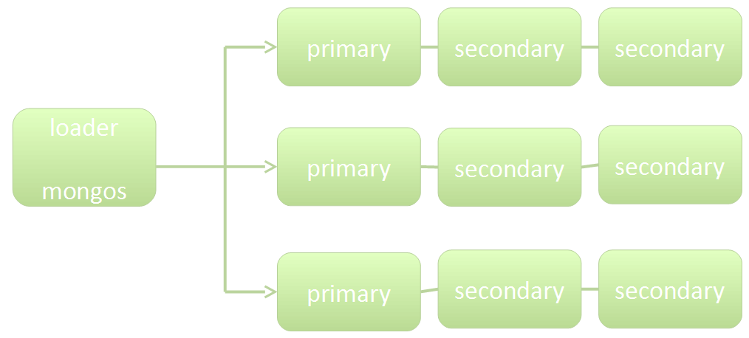
Loader Architecture
© ggk technologies
Notes:
Let us consider we have a single loader/query router for 3 shards

Slide 70
Loader Architecture
Where are the bottlenecks?
© ggk technologies

Slide 71
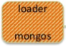
Loader Architecture
Where are the bottlenecks?
© ggk technologies
Notes:
This loader gets busy all the requests need to route with single.

Slide 72
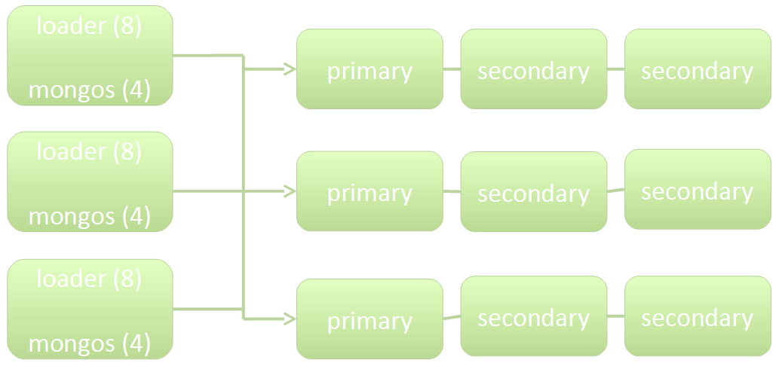
Loader Architecture
Use many threads
Use multiple loader servers
© ggk technologies
Notes:
So will have multiple mongos to even the distribute the request load.

Slide 73
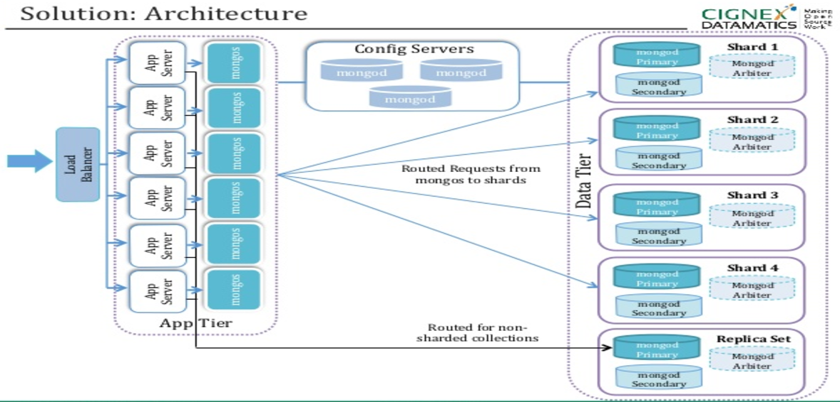

© ggk technologies
Notes:
To balance the requests load to the Mongos we can configure one/more Mongos to each App server, rest routing and fetching would be taken care by Mongos. As explained in the earlier slide Query routers are medium to distribute the load of the Query by fetching the information from the Config Servers. Mongos route the query to specific shard (node) and fetch the data from individual node which again do an aggregation/sort if necessary.

Slide 74
When Sharding
If you care about initial performance, you must pre-split
Otherwise, initial performance will be slow
Hash sharding automatically pre splits collection
© ggk technologies
Notes:
Prevention is better than cure. Will you all agree with me?
In the same way pre-split is better. Why? We will see that in our next slides.

Slide 75
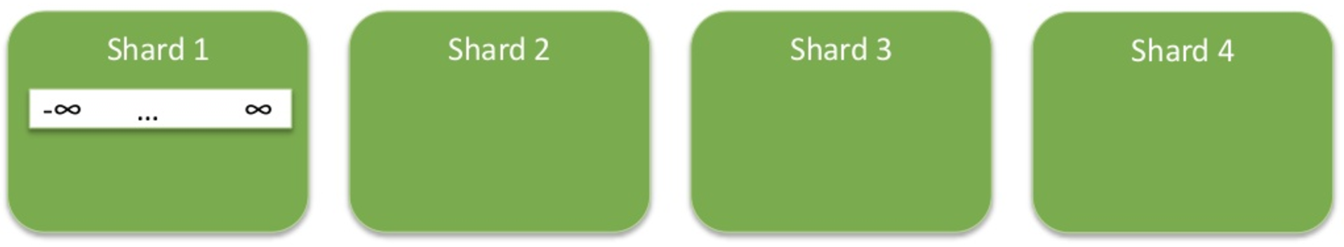
Without presplitting
sh.shardCollection(“records.patients”, {zipcode : 1})
© ggk technologies

Slide 76
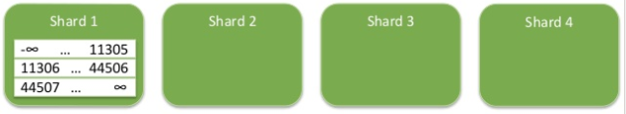
Without presplitting
64K chunks
Splitting will occur quickly
Balancing occurs much more slowly
The entire query workload shard1
© ggk technologies

Slide 77
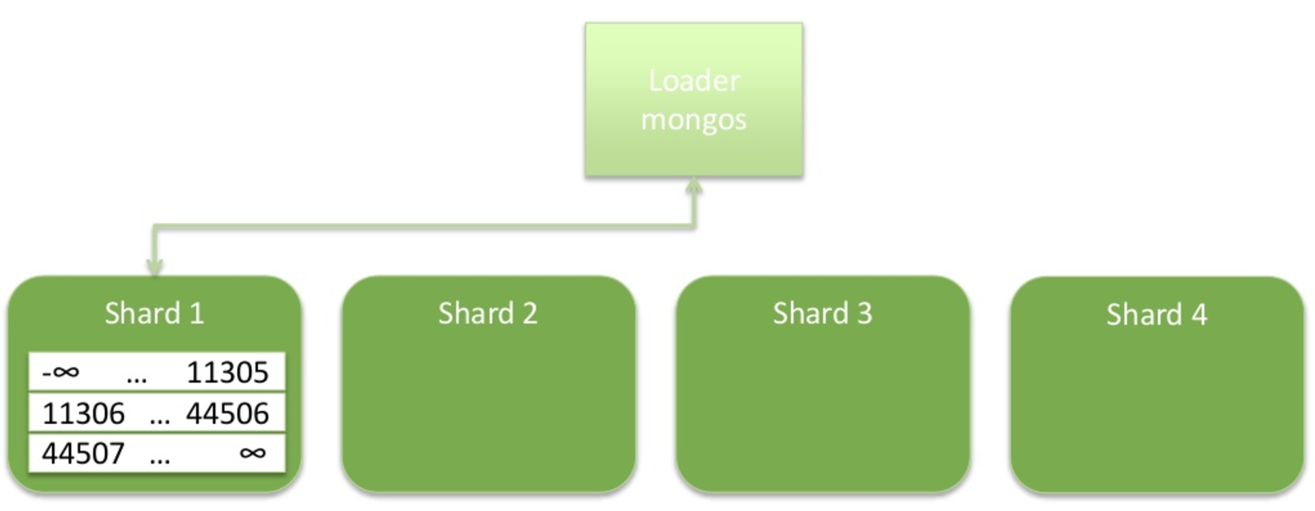
Without presplitting
© ggk technologies

Slide 78
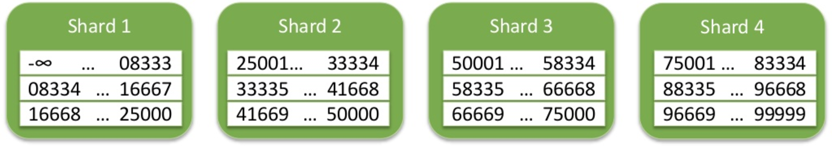
Split collection
Split and distribute empty chunks before loading any data
Evenly distribute query load across cluster
© ggk technologies

Slide 79
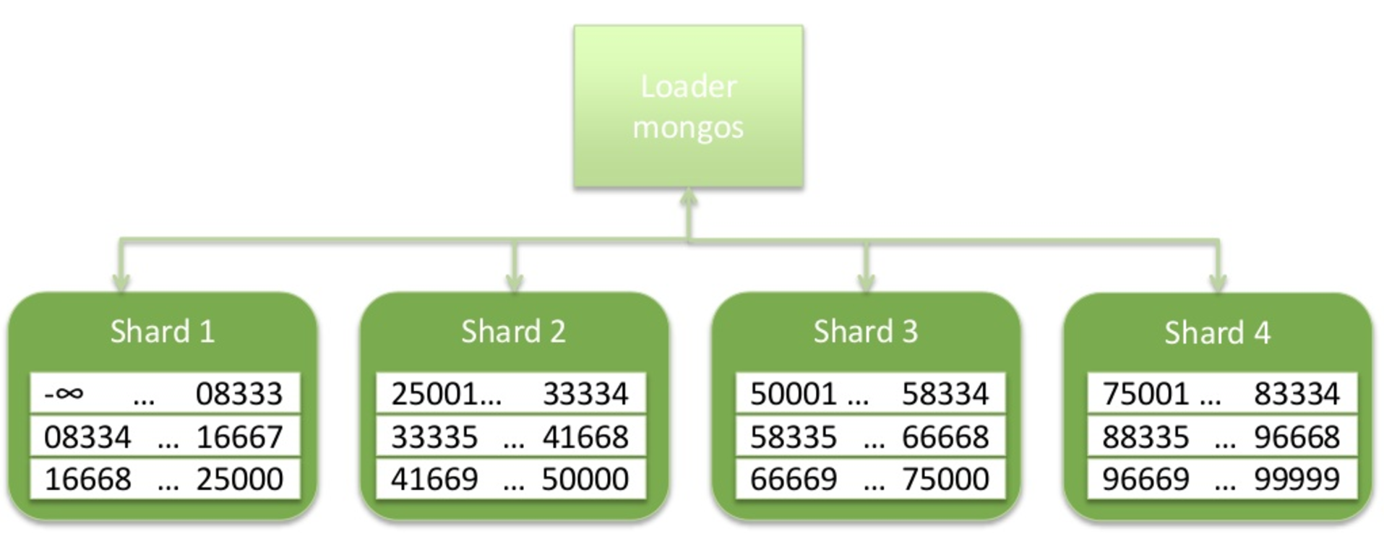
Split collection
© ggk technologies

Slide 80

© ggk technologies

Slide 81
Best Practices
Use servers with specifications that will provide good MongoDB performance
64+ GB RAM, many cores, many IOPS (RAID-10/SSDs)
Calculate How Many Shards?
Calculate required RAM and Disk Space
Build a prototype to determine the ops/sec capacity of a server
Do the math
Configure OS for Optimal MongoDB Performance
See MongoDB Production Notes
Create a Document Schema
Denormalized
© ggk technologies

Slide 82
Best Practices (cont.)
Design schema to application workload
Use application queries to guide schema design decisions
Consider alternative schemas
Compare cluster size (# of shards) and performance
Loading Data
Loader Hardware ~= MongoDB hardware
Many threads
Many mongos
Pre-split
Ensure query workload is evenly distributed across the cluster from the start
© ggk technologies

Slide 83

© ggk technologies

Slide 84


Never use a database because 'everybody else does'
Do your own Research
© ggk technologies

Slide 85

USE CASES THAT LEVERAGE MONGODB
© ggk technologies

Slide 86

PRODUCT CATALOG
E-Commerce
Product Catalog
Diverse product portfolio
Complex querying and filtering
Flash Sales
Scale for short bursts of high volume traffic
Scalable, but consistent view of inventory
© ggk technologies

Slide 87

Product Data
© ggk technologies

Slide 88

Content Management
News Site
Comments and user generated content
Personalization of content, layout
Multi-Device Rendering
Generate layout on the fly for each device that connects
No need to cache static pages
Sharing
Store large objects
Simple modeling of metadata
© ggk technologies

Slide 89

Content Management
© ggk technologies

Slide 90

User Data Management
Video Games
User State and Session Management
Social Graphs
Scale out to large graphs
Easy to search and process
Identity Management
Authentication, Authorization and Accounting
© ggk technologies

Slide 91

User Game State
© ggk technologies

Slide 92

Other MongoDB Use Cases
Storing Log Data
Pre-Aggregated Reports
Hierarchical Aggregation
Storing Comments
© ggk technologies

Slide 93
Use Cases where we never use MongoDB
Absolute Write Availability
Joins across Collections
Transactions over multiple documents
Graph traversal beyond two degrees of separation
Faceted Search
© ggk technologies

Slide 94

© ggk technologies

Slide 95

© ggk technologies

Slide 96


© ggk technologies

Slide 97

© ggk technologies

Slide 98


© ggk technologies

Slide 99
Agenda
Introduction
Architecture
Cassandra cluster
Cassandra architecture terms
Cassandra load balancing
Cassandra read and write process
Data Modelling
Use cases
Hardware/OS Recommendations
© ggk technologies

Slide 100



How it is different from RDBMS
© ggk technologies
Notes:
Row Key / Partition Key

Slide 101
Cassandra Column Cassandra Super Column
JSON Representation of Cassandra SuperColumn
{
name: "address",
value: {
city: {name: "city", value: "San Francisco", timestamp: 125555555},
street: {name: "street", value: "555 Union Street", timestamp: 125555555}
}
}
Super Column composed of:
a name (address)
a value composed of a map of Cassandra columns
Super Column is more like a container for Columns (a column contains a list of columns)
JSON Representation of Cassandra Column
{
name: "userName",
value: "Dave Jones",
timestamp: 125555555
}
A Cassandra column composes of
the name of the key (userName)
the value (Dave Jones)
Last updated timestamp
© ggk technologies

Slide 102

Follows A and P in CAP
© ggk technologies

Slide 103

Architecture and Components
Ring based Cluster
No Master/ Slave
Coordinator Node
Data Node/ Replica Node
Metadata everywhere
Gossip Protocol Service
© ggk technologies
Notes:
Indexes: Which will contains the SSTable Index which maps row keys to their respective offsets in the Data file Memtable and Commit log: When a write occurs, Cassandra stores the data in memory, the memtable, and also appends writes to the commit log on disk. SSTable: Cassandra creates a new SSTable when the data of a column family in Memtable is flushed to disk. Compaction: Compaction in Apache Cassandra refers to the operation of merging multiple SSTables into a single new one.
Admin: These terms are related to data maintenance. Tools: There are many tools which are used to manual flush memtables data into sstable, manual compaction of sstables, Repair node and etc. Monitoring: It will monitor compaction performance, Thread pool and read/write latency statistics and Table statistics. Uses all these information for diagnosing issues and for planning capacity when performance characteristics of a Cassandra cluster are critical. Bootstrap: Bootstrap service automatically redistributes cluster data when a new node is inserted. Hinted handoff: When a write is performed and a replica node for the row is either known to be down ahead of time, or does not respond to the write request, the coordinator will store a hint locally, in the system.hints table. And It runs all the stored hints of down node when it is live. Read repair: is an important component of keeping data consistent in a Cassandra cluster, because every time a read request occurs, it provides an opportunity for consistency improvement.
Tombstones: Tombstones are the deleted records in cassandra which are not deleted from disk.
Infrastructure: These terms are related to nodes and Architecture. Messaging: This protocol will be used when coordinator interacts with all other nodes in the form of message(ie; keep-alive process) and It also used to log errors, slow queries and etc. Gossip: is a peer-to-peer communication protocol in which nodes periodically exchange state information about themselves and about other nodes they know about. The gossip process runs every second and exchanges state messages with up to three other nodes in the cluster. Failure detection: is a method for locally determining from gossip state and history if another node in the system is up or down. Cassandra uses this information to avoid routing client requests to unreachable nodes whenever possible. Cluster state: cluster state will have all the node information up or down Partitioner: determines how data is distributed across the nodes in the cluster (including replicas). Basically, a partitioner is a function for deriving a token representing a row from its partion key, typically by hashing. Each row of data is then distributed across the cluster by the value of the token. Replication: Cassandra stores replicas on multiple nodes to ensure reliability and fault tolerance. A replication strategy determines the nodes where replicas are placed. The total number of replicas across the cluster is referred to as the replication factor.

Slide 104

Request Load balancing
Load balancing Policies
Round-robin
Datacenter-aware
Token-aware
Latency-aware
© ggk technologies
Notes:
Hector Pool: Creates a master pool of individual pools of connections based on the number of Cassandra nodes explicitly identified to Hector. Load balancing Policy: Load balancing policies are used to decide how to distribute requests among all possible coordinator nodes in the cluster.
Round-robin Load Balancing: This load balancing policy equally distributes queries across cluster without consideration of datacenter locality. This should only be used with Cassandra clusters where all nodes are located in the same datacenter.
Datacenter-aware Load Balancing: This load balancing policy equally distributes queries to nodes in the local datacenter. Nodes in remote datacenters are only used when all local nodes are unavailable.
Token-aware Routing: Token-aware routing uses the primary key of queries to route requests directly to the Cassandra nodes where the data is located. Using this policy avoids having to route requests through an extra coordinator node in the Cassandra cluster. This can improve query latency and reduce load on the Cassandra nodes.
Latency-aware Routing: Latency-aware routing tracks the latency of queries to avoid sending new queries to poorly performing Cassandra nodes.
Host Pool: Which will maintain node level connections information DiscoveryHostService: Which will discover the newly added cluster nodes. RetryDownHostService: It will try to start the temporarily downed node frequently.

Slide 105

Logical Write
Commit log
Memtable
SSTable
Compaction
Hinted handoff
Quorum
© ggk technologies
Notes:
Memtable and Commit log: When a write occurs, Cassandra stores the data in memory, the memtable, and also appends writes to the commit log on disk. Resides in Memory separately for each and every table.
SSTable: Cassandra creates a new SSTable when the data of a column family in Memtable is flushed to disk.
Compaction: Compaction in Apache Cassandra refers to the operation of merging multiple SSTables into a single new one.
Hinted handoff: When a write is performed and a replica node for the row is either known to be down ahead of time, or does not respond to the write request, the coordinator will store a hint locally, in the system.hints table. And It runs all the stored hints of down node when it is live.
Quorum: Majority in replica set. More than half of the existing nodes define a Quorum.

Slide 106

Physical Write
© ggk technologies
Notes:
For the write operation, Cassandra processes data at several stages on the write path, starting with the immediate logging of a write and ending in with a write of data to disk:
Logging data in the commit log
Writing data to the memtable
Flushing data from the memtable
Storing data on disk in SSTables
Logging writes and memtable storage:
When a write occurs, Cassandra stores the data in a memory structure called memtable, and to provide configurable durability, it also appends writes to the commit log on disk. The commit log receives every write made to a Cassandra node, and these durable writes survive permanently even if power fails on a node. The memtable is a write-back cache of data partitions that Cassandra looks up by key. The memtable stores writes in sorted order until reaching a configurable limit, and then is flushed.
Flushing data from the memtable:
Cassandra writes the data to disk, in the memtable-sorted order. A partition index is also created on the disk that maps the tokens to a location on disk. You can manually flush a table using nodetool flush or nodetool drain (flushes memtables without listening for connections to other nodes). To reduce the commit log replay time, the recommended best practice is to flush the memtable before you restart the nodes. If a node stops working, replaying the commit log restores to the memtable the writes that were there before it stopped. Storing data on disk in SSTables:
Data in the commit log is purged after its corresponding data in the memtable is flushed to an SSTable on disk. Memtables and SSTables are maintained per table. The commit log is shared among tables. SSTables are
immutable, not written to again after the memtable is flushed. Consequently, a partition is typically stored across multiple SSTable files.

Slide 107

Logical read
© ggk technologies
Notes:
For the read operation, Cassandra must combine results from the active memtable and potentially multiple SSTables. Cassandra processes data at several stages on the read path to discover where the data is stored, starting with the data in the memtable and finishing with SSTables:
Check the memtable
Check row cache, if enabled
Checks Bloom filter
Checks partition key cache, if enabled
Goes directly to the compression offset map if a partition key is found in the partition key cache, or checks the partition summary if not
If the partition summary is checked, then the partition index is accessed
Locates the data on disk using the compression offset map
Fetches the data from the SSTable on disk
Memtable:
If the memtable has the desired partition data, then the data is read and then merged with the data from the SSTables.
Row Cache:
Typical of any database, reads are fastest when the most in-demand data fits into memory. The operating system page cache is best at improving performance, although the row cache can provide some improvement for very read-intensive operations, where read operations are 95% of the load. The row cache, if enabled, stores a subset of the partition data stored on disk in the SSTables in memory. The row cache uses LRU (least-recently-used) eviction to reclaim memory when the cache has filled up. The row cache size is configurable. If a write comes in for the row, the cache for that row is invalidated and is not cached again until the row is read.
Bloom Filter:
Cassandra checks the Bloom filter to discover the SSTables which are likely to have the request partition data. The Bloom filter is stored in off-heap memory. Each SSTable has a Bloom filter associated with it. A Bloom filter can establish that a SSTable does not contain certain partition data. A Bloom filter can also find the likelihood that partition data is stored in a SSTable.
Partition Key Cache:
The partition key cache, if enabled, stores a cache of the partition index in off-heap memory. The key cache uses a small, configurable amount of memory, and each "hit" saves one seek during the read operation. If a partition key is found in the key cache can go directly to the compression offset map to find the compressed block on disk that has the data. The partition key cache functions better once warmed, and can greatly improve over the performance of cold-start reads, where the key cache doesn't yet have or has purged the keys stored in the key cache. It is possible to limit the number of partition keys saved in the key cache, if memory is very limited on a node. If a partition key is not found in the key cache, then the partition summary is searched.
Partition Summary:
The partition summary is an off-heap in-memory structure that stores a sampling of the partition index. A partition index contains all partition keys, whereas a partition summary samples every X keys, and maps the location of every Xth key's location in the index file. While not as exact as knowing the location of the partition key, the partition summary can shorten the scan to find the partition data location. After finding the range of possible partition key values, the partition index is searched.
Partition Index:
The partition index resides on disk and stores an index of all partition keys mapped to their offset. If the partition summary has been checked for a range of partition keys, now the search passes to the partition index to seek the location of the desired partition key. A single seek and sequential read of the columns over the passed-in range is performed. Using the information found, the partition index now goes to the compression offset map to find the compressed block on disk that has the data. If the partition index must be searched, two seeks to disk will be required to find the desired data.
Compression offset map:
The compression offset map stores pointers to the exact location on disk that the desired partition data will be found. It is stored in off-heap memory and is accessed by either the partition key cache or the partition index. The desired compressed partition data is fetched from the correct SSTable(s) once the compression offset map identifies the disk location.

Slide 108

Physical read
© ggk technologies
Notes:
Best case scenario:
Hit row cache – row cache is optional b/c typically row cache is duplicate of OS file system cache (both goes to RAM)
Second best case scenario:
hit key cache
Worst case scenario:
Don’t hit key cache and goes through partition summary and partition index
Tombstones: Tombstones are the deleted records in cassandra which are not deleted from disk.
Read repair: is an important component of keeping data consistent in a Cassandra cluster, because every time a read request occurs, it provides an opportunity for consistency improvement.

Slide 109
Picking Consistency Levels
It is common to pick read and write consistency levels that are high enough to overlap, resulting in “strong” consistency.
Write Consistency + Read Consistency
> Replication Factor
© ggk technologies

Slide 110
Data Modeling
rdbms: domain-based model
what answers do I have?
cassandra: query-based model
what questions do I have?
© ggk technologies

Slide 111

Simple Use Case
© ggk technologies

Slide 112

Relational Data model
© ggk technologies

Slide 113

Cassandra Query model
© ggk technologies

Slide 114

Selecting Partition Key and Clustering Column
© ggk technologies

Slide 115

Selecting Partition Key and Clustering Column
© ggk technologies

Slide 116
Data model Enhancement
User Defined Data Type
Complex data in one place
No multi-gets (multi-partitions)
Nesting
CREATE TYPE address (
street text,
city text,
zip_code int,
country text,
cross_streets set<text>
);
© ggk technologies

Slide 117

Before Introducing UDDT
© ggk technologies

Slide 118

After Introducing UDDT
© ggk technologies

Slide 119

Let’s Consider Storage in JSON
© ggk technologies

Slide 120
Including Hash to follow rule
Example 1: User Groups
We want to get the full user info for every user in a particular group. Order of users matter.
We can use a compound PRIMARY KEY for this:
CREATE TABLE groups (
groupname text,
username text,
email text,
age int,
PRIMARY KEY (groupname, username)
)
If we want to spread the load more evenly,
CREATE TABLE groups (
groupname text,
username text,
email text,
age int,
hash_prefix int,
PRIMARY KEY ((groupname, hash_prefix), username)
)
© ggk technologies
Notes:
How do we fit a group into a partition?

Slide 121

SECONDARY Indexes:
© ggk technologies
Notes:
Secondary indexes are used to filter a table for data stored in non-primary key columns.
Secondary indexes can be built for a column in a table.
These indexes are stored locally on each node in a hidden table and built in a background process.
If a secondary index is used in a query that is not restricted to a particular partition key, the query will have prohibitive read latency because all nodes will be queried.
A query with these parameters is only allowed if the query option ALLOW FILTERING is used.
This option is not appropriate for production environments. If a query includes both a partition key condition and a secondary index column condition, the query will be successful because the query can be directed to a single node partition.

Slide 122
Basic Rules of Cassandra Data Modeling
Spread data evenly around the cluster
pick a good Partition Key
Minimize the number of partitions read
read rows from as few partitions as possible
© ggk technologies
Notes:
You want every node in the cluster to have roughly the same amount of data. Cassandra makes this easy, but it's not a given. Rows are spread around the cluster based on a hash of the partition key, which is the first element of the PRIMARY KEY.
Partitions are groups of rows that share the same partition key. Each partition may reside on a different node. The coordinator will generally need to issue separate commands to separate nodes for each partition you request. This adds a lot of overhead and increases the variation in latency. Furthermore, even on a single node, it's more expensive to read from multiple partitions than from a single one due to the way rows are stored.

Slide 123
Shopping Cart
Customers give us money is a good reason for uptime
© ggk technologies

Slide 124
Shopping cart use case
Store shopping cart data reliably
Minimize (or eliminate) downtime. Multi - dc
Scale for the “Big Billion Day” or “Flash Sale” problem
The bad
Every minute off - line is lost $$
Online shoppers want speed!
© ggk technologies

Slide 125
Shopping cart use case
Each customer can have one or more shopping carts
De-normalize data for fast access
Shopping cart == One partition
Each item a new column
Partition key |  | Wide Row
User name | Cart ID | {'Related':'Timex foot pod', 'Volume Discount':'25'}
© ggk technologies

Slide 126
Shopping cart use case
CREATE TABLE shopping_cart (
username varchar,
cart_name text
item_id int,
item_name varchar,
description varchar,
price float,
item_detail map <varchar,varchar>
PARTITION KEY ((username,cart_name),
item_id)
);
INSERT INTO shopping_cart
(username,cart_name,item_id,item_name,description,price,item_detail)
VALUES ('XyZ','Gadgets I want',9748575,'Polaris Foot
Pod','Bluetooth Smart foot pod',64.00
{'Related':'Timex foot pod',
'Volume Discount':'25'});
© ggk technologies

Slide 127
User Activity Tracking
Watching users, making decisions.
© ggk technologies

Slide 128
User Activity use case
React to user input in real time
Support for multiple application pods
Scale for speed
The bad
Losing interactions is costly
© ggk technologies

Slide 129

User Activity use case
Interaction points stored per user in short table
Long term interaction stored in similar table with date partition
Process long term later using batch
Reverse time series to get last N items
© ggk technologies

Slide 130
Hardware specifications
Memory
The ideal amount of RAM depends on the anticipated size of your hot data.
Production: 32 GB to 512 GB; the minimum is 8 GB for Cassandra nodes.
Development in non-loading testing environments: no less than 4 GB.
CPU
Production environments: 16-core CPU processors.
Non-loading testing environments: 2-core CPU processors are sufficient.
Storage
Database size - 5GB
Compaction process takes 2x of size - 10GB
Recommended replica sets - 3
Maximum Storage recommendation - 500GB / Node
Number of Discs - 2
One for Commit log
One for SSTables
© ggk technologies
Notes:
Memory : The more memory a Cassandra node has, the better read performance. More RAM also allows memory tables (memtables) to hold more recently written data. Larger memtables lead to a fewer number of SSTables being flushed to disk, more data held in the operating system page cache, and fewer files to scan from disk during a read. The ideal amount of RAM depends on the anticipated size of your hot data. CPU : Insert-heavy workloads are CPU-bound in Cassandra before becoming memory-bound. (All writes go to the commit log, but Cassandra is so efficient in writing that the CPU is the limiting factor.) Cassandra is highly concurrent and uses as many CPU cores as available.
Node storage space will depend on your database size, no of nodes and no of replications that you need. Let’s take if you have 5 GB of database size, 3 nodes in the cluster and you are replicating it 3 times in cluster. Then, you have to maintain 10 GB sized nodes because compaction process takes maximum 2x size of your datasize. So, finally cluster size should be 30 GB.
It should not cross the node storage space more than 500 GB. Better to have 5+ nodes if you have data more than TBs of size.

Slide 131

© ggk technologies

Slide 132


© ggk technologies

Slide 133

AGENDA..
Graph DB introduction
Neo4J Highlights
Neo4J Key components
CYPHER Introduction
Data Storage
Data Modeling
Cluster Concepts
Use cases
Best Practices
© ggk technologies

Slide 134

Graph DB Introduction
What is a Graph?
Stores data in the form of Graphs
Graph DBs are extremely useful to store highly connected data (Which is Drawback of RDBMS)
Graph Model
© ggk technologies
Notes:
Graph database is a type of NoSQL database that uses graph theory to store, map and query relationships.
Each node represents an entity (such as a person or business) and each edge represents a connection or relationship between two nodes
Above pic represents how a graph works with relationships.

Slide 135

About Neo4j
Neo4j is a leading Graph Database system.
Highlights:
Native Graph storage
Whiteboard Friendly And Supports Rapid Development
Supports Transactions.
Powerful coding language
Supports High Availability
© ggk technologies
Notes:
Neo4J 3.2

Slide 136

Components Explanation
Key Components:
Nodes
Labels
Relationships
Properties
RDBMS | Neo4j
Record | Node
Columns | Node Properties
Table Name | Label Name
Column Name | Property Name
Column Value | Property Value
© ggk technologies
Notes:
Single Node can have multiple Labels
Relationships are Directional

Slide 137

© ggk technologies

Slide 138

CYPHER
Cypher is a declarative graph query language that allows for expressive and efficient querying and updating of a property graph
It supports all CRUD Operations
Case Sensitive
Key Commands: CREATE, MATCH, RETURN, WHERE..
Creation Syntax : CREATE(<node-name>:<label-name>{Properties list as key value pair })
Example:
CREATE(S:Student {name:"Shruthi",id:565}), CREATE(L:Lecturer {name:"Sukanya",id:753}) CREATE(L) -[R:Teaches]-> (S) RETURN R
© ggk technologies
Notes:
It is case sensitive
Need very less no of Coding lines compared to SQL
CREATE, MATCH, RETURN, WHERE

Slide 139



Data Storage
© ggk technologies

Slide 140

Data Modeling
A graph data model is designed to answer questions in the form of Cypher queries.
Let us consider simple problem statement and will see how it is designed in neo4j
Statement:
Two people, John and Sally, are friends. Both John and Sally have read the book, Graph Databases.
We can take this statement, identify components such as labels, nodes, and relationships, and use these to build our model.
© ggk technologies

Slide 141

Neo4j - Data Model Components
There are 4 building blocks for modelling the data in Neo4j
Nodes
Labels
Relationships
Properties
© ggk technologies

Slide 142

Nodes
The first entity that we’ll identify in any domain are nodes.
The fundamental units that form a graph are nodes and relationships. In Neo4j, both nodes and relationships can contain properties.
Extracting Nodes:
© ggk technologies

Slide 143

Labels
Now that we have an idea of what our nodes will be, we decide what labels (if any) to assign our nodes.
A label is a named graph construct that is used to group nodes into sets.
Many database queries can work with these sets instead of the whole graph, making queries easier to write and more efficient.
A node may be labeled with any number of labels, including none, making labels an optional addition to the graph.
Extracting Labels:
© ggk technologies

Slide 144

Nodes - Labels
Assigning Nodes to Labels:
Now that we have identified both our nodes and labels, we can assign the labels to the nodes they describe. For John and Sally we apply the role Person. For Graph Databases we apply the role Book.
Blue- Person label
Green- Book label
© ggk technologies

Slide 145
Relationships
Further, we need to identify the interactions between these subjects:
John is a friend of Sally
Sally is a friend of John
John has read Graph Databases
Sally has read Graph Databases
Pairs of nodes labeled Person can be connected to each other by the friend of relationship.
Pairs of nodes labeled Book and Person can be connected to each other by a has read relationship.
© ggk technologies

Slide 146

Data Model - Without Properties
© ggk technologies

Slide 147
Properties
Defining Properties for Relationships and Nodes:
For Below questions we can get answers through Cypher once the Graph is completely established.
When did John and Sally become friends?
What is the average rating of the book Graph Databases?
Who is the author of the book Graph Databases?
How old is Sally?
How old is John?
Who is older, Sally or John?
Who read the book Graph Databases first, Sally or John?
From these list of questions, we can identify the attributes that must belong to entities within our data model.
© ggk technologies

Slide 148

Data Model - With Properties
© ggk technologies

Slide 149


Sample Data Model - Order Details
SQL Server
Neo4j
© ggk technologies

Slide 150

Neo4j Cluster
There are 2 types of Clusters Available in Neo4j
HA Cluster (Availability)
Causal Cluster (Consistency)
© ggk technologies

Slide 151


HA (High Availability) Cluster
Neo4j high availability (HA) uses a master-slave cluster architecture.
Key components of cluster
Cluster Management
Transaction Propagation
Data base
Load Balancer
© ggk technologies

Slide 152


HA Cluster - Write Flow
Request on Master
Request on Slave
© ggk technologies

Slide 153

HA Cluster - Configurations & Limitations
Configurations:
Limitations:
The full graph is replicated to each instance in the cluster (i.e. the full dataset is replicated across the entire cluster, to each server).
A consequence of this is that all data needs to ﬁt within the capacity of a single Neo4j instance.
It house at most 34 billion nodes, 34 billion relationships, and 68 billion properties, in total.
© ggk technologies

Slide 154

Neo4j Causal Cluster
Neo4j’s Causal Clustering provides three main features:
Safety
Scale
Causal Consistency
© ggk technologies
Notes:
Safety: Core Servers provide a fault tolerant platform for transaction processing which will remain available while a simple majority of those Core Servers are functioning.
Scale: Read Replicas provide a massively scalable platform for graph queries that enables very large graph workloads to be executed in a widely distributed topology.
Causal consistency: when invoked, a client application is guaranteed to read at least its own writes.

Slide 155

Key components
Core Servers
Replica Server
Discovery Protocol
Raft Protocol
Transaction shipping
© ggk technologies

Slide 156
Causal Cluster - Discovery Protocol
Discovery Protocol:
Discovery protocol is the first step in forming a Causal Cluster.
Discovery service continues to run throughout the lifetime of the Causal Cluster
It takes hints about existing Core cluster servers
using causal_clustering.initial_discovery_members
On consuming the hints the server will try to handshake with the other listed servers.
On successful handshake with another server or servers the current server will discover the whole current topology.
© ggk technologies

Slide 157

Raft Protocol & Transaction Shipping
Raft ensures that the data is safely durable before confirming transaction commit to the end user application
Maintains Raft log where it keeps Transaction commands
Raft also handles Cluster membership by maintaining distributed log
Read Replicas are asynchronously replicated from Core Servers via transaction log shipping
Read replica will poll a Core Server for any new transactions that it has processed since the last poll, and the Core Server will ship those transactions to the Read replica

Slide 158

Read / Write Flow - Without Bookmark
© ggk technologies

Slide 159


Read / Write Flow - With Bookmark
© ggk technologies

Slide 160

© ggk technologies

Slide 161


Fraud Detection
Our lives become increasingly digital, a growing number of financial transactions are conducted online.
Fraudsters have adapted quickly to this trend and have devised clever ways to defraud online payment systems.
For Example :
Consider an online transaction with the following identifiers: user ID, IP address, geo location, a tracking cookie and a credit card number.
Typically, the relationships between these identifiers should be (almost) one-to-one. Some variations naturally account for shared machines, families sharing a single credit card number, individuals using multiple computers and the like.
© ggk technologies

Slide 162
Fraud Detection (cont.)
Way of detection:
The relationships between these variables exceed a reasonable number, fraud should be considered as a strong possibility.
The more interconnections exist amongst identifiers, the greater the cause for concern.
As business processes become faster and more automated, the time margins for detecting fraud are narrowing, increasing the need for a real-time solution.
Traditional technologies are not designed to detect elaborate fraud rings. Graph databases add value through analysis of connected data points
Graph databases are the ideal enabler for efficient and manageable fraud detection solutions. From fraud rings and collusive groups, to educated criminals operating on their own, graph databases uncover a variety of important fraud patterns – and all in real time.
© ggk technologies

Slide 163

Real Time Recommendations
Real-time recommendations is essential to maximizing customer value and staying competitive
But to achieve this requires data products that can connect masses of complex buyer and product data (and connected data in general) to gain insight into customer needs and product trends, super-fast. Walmart recognized the challenge it faced in delivering this with traditional relational database technology.
Solution:
“A relational database wasn’t satisfying our requirements about performance and simplicity, due the complexity of our queries.” ---Macros director of Walmart
To address this, Marcos’ team decided to use Neo4j, Graph databases can quickly query customer’s past purchases, as well as instantly capture any new interests shown in the customer's current online visit – essential for making real-time Matching historical and session data in this way is trivial for graph databases like Neo4j, enabling them to easily outperform relational and other ‘NoSQL’ data products.
© ggk technologies

Slide 164

More Business Use cases
Below are the Graph DB use cases
Fraud Detection -Fortune500 Finance
Graph based search -adidas
Real Time Recommendations -Walmart
Master data Management -IBM
Social Network (LinkedIn)
© ggk technologies

Slide 165

Best Practices
Choose appropriate cluster to be build based on business requirement
Availability: (HA cluster)
Consistency: (Causal Cluster)
When synchronous clusters implemented, choose the number of servers appropriately based on business requirement as it affects write throughput.
Use Load CSV for loads upto 10 million nodes and relationships.
Use Command-Line Bulk Loader (neo4j - import) for loads with 10B+ records (It loads 1M records per second).
© ggk technologies

Slide 166

© ggk technologies

Slide 167


© ggk technologies

Slide 168
Agenda
Introduction to MarkLogic
Architecture
Read/Write process
Data modelling
Semantics & Data distribution
Searching, Indexes, Scalability, and ACID compliancy
Use cases
© ggk technologies
Notes:
MarkLogic combines an Enterprise NoSQL database with an advanced search engine within a single package.
This allows data to be loaded into the system as-is, where it is fully indexed and ready for searching – with no advance data modelling or schema design required. As data flows into the database, entities can be identified and information enriched – either automatically or via user-controlled editing.
A place name, for example, could be enriched with coordinate information.
This makes the information more easily searchable, accessible, and valuable for analysis.
Once entities are found, they can be used to explore the data and find links between different documents.
A wide range of binary documents can be handled by MarkLogic out of the box.

Slide 169

Why MarkLogic?
Document centric & Multi model
Rich search features
Scalability
ACID compliant (Not CAP)
Schema agnostic
High availability
© ggk technologies
Notes:
Document Centric:
MarkLogic uses documents, often written in XML or JSON, as one of its core data models.
In addition to XML and JSON, MarkLogic can store text documents, binary documents, and semantic (RDF) triples.
Text documents are indexed as if each were an XML text node without a parent.
Binary documents are by default unindexed, with the option to index their metadata and extracted contents.
MarkLogic turns RDF triples into an XML representation and then stores them as XML documents.
Multi model:
MarkLogic also stores semantic data as subject-predicate-object structures known as RDF triples.
Triples describe relationships among data entities.
By offering both the document model and the semantic model, MarkLogic becomes a multi-model database.
Programmable:
To interact with and program MarkLogic Server at the lowest level, you can use XQuery, JavaScript, and SPARQL.
MarkLogic operates on HTTP or HTTPS, XDBC protocol, REST API, SQL.
ACID compliant:
You can insert or update a set of documents as an atomic unit and have the very next query be able to see those changes with zero latency.
MarkLogic supports the full set of ACID properties:
Atomicity (a set of changes either takes place as a whole or doesn't take place at all),
Consistency (system rules are enforced, such as that no two documents should have the same identifier),
Isolation (uncompleted transactions are not otherwise visible),
Durability (once a commit is made it will not be lost).
Schema Agnostic:
MarkLogic indexes the XML or JSON structure it sees during ingestion, whatever that structure might be.
It doesn't have to be told what schema to expect, any more than a search engine has to be told what words exist in the dictionary.
Point in time recovery:
You can configure MarkLogic Server to retain old versions of documents, allowing you to evaluate a query statement as if you had travelled back to a point-in-time in the past.
When you specify a timestamp at which a query statement should evaluate, that statement will evaluate against the newest version of the database up to (but not beyond) the specified timestamp.

Slide 170

MarkLogic- An Enterprise NoSQL Platform
© ggk technologies
Notes:
A bitemporal database allows you to query across system and valid time axes. You can go back in time and explore data, manage historical data across systems, ensure data integrity, and do complex bitemporal analysis with ease.
The process of 'inference' involves the automated discovery of new facts based on a combination of data and rules for understanding that data. Inference is the process of 'inferring' or discovering new facts about your data based on a set of rules. Inference with semantic triples means that automatic procedures can generate new relationships (new facts) from existing triples.
MarkLogic Server allows you to manage your data at different tiers of storage and computation environments, with the top-most tier providing the fastest access to your most critical data and the lowest tier providing the slowest access to your least critical data.

Slide 171

Multi-model Database
© ggk technologies

Slide 172

MarkLogic Fundamental Architecture
© ggk technologies
Notes:
In E-node:
A client request comes to MarkLogic Server to a port on the App Server.
The App Server directs the request to the Query Evaluator.
If anything in those stored procedures needs data, then the Evaluator Node needs to go get the data from the forests and the Data Nodes.
The Broadcaster will ask all the D-nodes for the data that it needs
In a cluster, this will be more than one host, so there will be a network cost.
The D-nodes individually process the query request and send back compressed data to the Evaluator Node
The Aggregator uncompresses and collates all the responses and returns them back to the App Server and to the calling client.
STEPS:
Our query comes into the App Server
Then the Query Evaluator executes whatever server-side code needs to run.
If that query requires data, the Broadcaster sends the request out to all the D-nodes that host forests currently enabled for that database.
The request then hits the D-node
If the request is simply “return me this document,” the D-node will check to see if it has that document in any of the local forests.
If it does, it will check the Compressed Tree Cache to see if the document is there.
If it is there, the D-node just sends that in-memory document back to the E-node.
The E-node checks the Expanded Tree Cache to see if the document is already in-memory.
If not, the E-node expands that in-memory compressed tree data into the full XML or JSON and places the fully expanded tree into the Expanded Tree Cache on the E-node.
The document is then returned to the client via the App Server port. Meanwhile, all the other D-nodes in the cluster are responding to the Aggregator, saying, “No, I don’t have that document.”
It’s also important to note that the in-memory stand is part of all this query processing – the documents in the in-memory stand are included in the result set if they match the query.

Slide 173

MarkLogic 3 Tier Architecture
© ggk technologies
Notes:
In E-node:
A client request comes to MarkLogic Server to a port on the App Server.
The App Server directs the request to the Query Evaluator.
If anything in those stored procedures needs data, then the Evaluator Node needs to go get the data from the forests and the Data Nodes.
The Broadcaster will ask all the D-nodes for the data that it needs
In a cluster, this will be more than one host, so there will be a network cost.
The D-nodes individually process the query request and send back compressed data to the Evaluator Node
The Aggregator uncompresses and collates all the responses and returns them back to the App Server and to the calling client.
STEPS:
Our query comes into the App Server
Then the Query Evaluator executes whatever server-side code needs to run.
If that query requires data, the Broadcaster sends the request out to all the D-nodes that host forests currently enabled for that database.
The request then hits the D-node
If the request is simply “return me this document,” the D-node will check to see if it has that document in any of the local forests.
If it does, it will check the Compressed Tree Cache to see if the document is there.
If it is there, the D-node just sends that in-memory document back to the E-node.
The E-node checks the Expanded Tree Cache to see if the document is already in-memory.
If not, the E-node expands that in-memory compressed tree data into the full XML or JSON and places the fully expanded tree into the Expanded Tree Cache on the E-node.
The document is then returned to the client via the App Server port. Meanwhile, all the other D-nodes in the cluster are responding to the Aggregator, saying, “No, I don’t have that document.”
It’s also important to note that the in-memory stand is part of all this query processing – the documents in the in-memory stand are included in the result set if they match the query.

Slide 174

Horizontal Scalability
© ggk technologies

Slide 175

MarkLogic Read/Write Flow
© ggk technologies
Notes:
Clustering:
You can combine multiple instances of MarkLogic to run as a cluster.
The cluster has multiple machines (hosts), each running an instance of MarkLogic Server.
Each host in a cluster is sometimes called a node, and each node in the cluster has its own copy of all of the configuration information for the entire cluster.
When deployed as a cluster, MarkLogic implements a shared-nothing architecture.
There is no single host in charge; each host communicates with every other host, and each node in the cluster maintains its own copy of the configuration.
This shared-nothing architecture has great advantages when it comes to scalability and availability.
As your scalability needs grow, you simply add more nodes.
Clustering MarkLogic provides four key advantages:
The ability to use commodity servers, bought for reasonable prices.
The ability to incrementally add (or remove) new servers as need demands.
The ability to maximize cache locality, by having different servers optimized for different roles and managing different parts of the data.
The ability to include failover capabilities to handle server failures.
Communication between nodes:
Each node in a cluster communicates with all of the other nodes in the cluster at periodic intervals. - heartbeat
It circulates key information about host status and availability between the nodes in a cluster.
If a node goes down for some reason, it stops sending heartbeats to the other nodes in the cluster.
A heartbeat from a given node communicates its view of the cluster at the moment of the heartbeat.
To vote a node out of the cluster, there must be a quorum of nodes voting to remove a node.
The voting that each host performs is done based on how long it has been since it last had a heartbeat from the other node.
If at half or more of the nodes in the cluster determine that a node is down, then that node is disconnected from the cluster.
If the server is configured to listen on a socket for incoming requests (HTTP, XDBC, WebDAV, etc), then it is an E-node. If it manages data (has one or more attached forests), then it is a D-node.

Slide 176

Document Assignment policies
BUCKET ASSIGNMENT POLICY
© ggk technologies
Notes:
By default Legacy Assignment policy

Slide 177

Document Assignment policies
RANGE ASSIGNMENT POLICY
© ggk technologies

Slide 178
Best Practices - Hardware
The rule-of-thumb for the maximum size of a forest is 256GB per forest
It is recommended to have a disk size of 1.5 times the size of forest, and 2 CPU cores per forest.
For Large Scale applications it is recommended to have:
Separate E-Nodes and D-Nodes
Multi Layered Storage architecture - Stores frequently access data in SSD, Less frequently accessed data in HDD, and archived data in Cloud
© ggk technologies
Notes:
In E-node:
A client request comes to MarkLogic Server to a port on the App Server.
The App Server directs the request to the Query Evaluator.
If anything in those stored procedures needs data, then the Evaluator Node needs to go get the data from the forests and the Data Nodes.
The Broadcaster will ask all the D-nodes for the data that it needs
In a cluster, this will be more than one host, so there will be a network cost.
The D-nodes individually process the query request and send back compressed data to the Evaluator Node
The Aggregator uncompresses and collates all the responses and returns them back to the App Server and to the calling client.
STEPS:
Our query comes into the App Server
Then the Query Evaluator executes whatever server-side code needs to run.
If that query requires data, the Broadcaster sends the request out to all the D-nodes that host forests currently enabled for that database.
The request then hits the D-node
If the request is simply “return me this document,” the D-node will check to see if it has that document in any of the local forests.
If it does, it will check the Compressed Tree Cache to see if the document is there.
If it is there, the D-node just sends that in-memory document back to the E-node.
The E-node checks the Expanded Tree Cache to see if the document is already in-memory.
If not, the E-node expands that in-memory compressed tree data into the full XML or JSON and places the fully expanded tree into the Expanded Tree Cache on the E-node.
The document is then returned to the client via the App Server port. Meanwhile, all the other D-nodes in the cluster are responding to the Aggregator, saying, “No, I don’t have that document.”
It’s also important to note that the in-memory stand is part of all this query processing – the documents in the in-memory stand are included in the result set if they match the query.

Slide 179

Data Modelling in MarkLogic
© ggk technologies
Notes:
Figure provides a good overview of the components generally needed to create an application based on a relational database.
As we can see, most of the data providers, data consumers, and data processing consist of hierarchical tree like structures; however, the persistence layer is very different.
When building such applications, programmers generally start by looking at the business requirements and create objects that match those needs.
Relational databases with normal form-focused data designs "shred" those data sets across multiple tables.
In order to abstract away this complexity, developers deploy logical modeling tools and object relational mapping (ORM) tools.
Searching through those data sets requires yet another set of products with the accompanying need to synchronize the indexes with the ever-changing data.
Communicating with the front end GUI is usually done through HTML or JSON (tree structures).
Communicating with other services via APIs is usually performed through REST/SOAP with content in JSON/XML (still more tree structures).
Reference data is imported via JSON, XML, RDF, or CSVs (a lot of which can be modeled as trees or semantic relationships).

Slide 180

SQL Modelling of data
Can Model elements of a document as columns of a sql table using views
Can be queried using SQLite to get data as tables
BI reporting tools can connect to MarkLogic using ODBC connection to get relational data for analysis
© ggk technologies
Notes:
View:
Representation of an SQL View
Implemented as an XML doc and consists of a unique id, a name, a view scope and a sequence of column specifications
May include fields with MATCH operator queries
Schema:
Representation of an SQL Schema
Provides naming content for its views during SQL execution
Column:
This in a view has a name and range index reference that identifies a particular document element and attribute.
View scope:
Constrains the subset of the database to which the view applies.
We need to have view-admin role to execute functions in view library.

Slide 181


Supports semantic data storage
Stores data in the form of Semantic triples
A triple consists of Subject, Object and predicate
© ggk technologies

Slide 182

Searching
Rich full-text search features
Wide variety of Indexes to support word, element, path searches etc.,
Stemming
Wildcarded Searches
Diacritic Sensitive/Insensitive searches
Thesaurus and Spelling correction functions
Geospatial search features
© ggk technologies
Notes:
While evaluating search expression has 2 step process
Index resolution - happens in D-nodes
Filtering - happens in E-nodes
Index resolution:
A list of candidate fragment IDs is generated directly from the indexes, based on the index resolvable criteria incorporated in the various parameters passed to search.
Fragment IDs are ordered according to relevance criteria.
Purpose of index resolution is to narrow the set of candidate fragments to as small a set as possible without missing any.
Filtering:
Optionally, if specified, a candidate fragment ID is used to load fragments from disk.
Each fragment is then examined in order using complete criteria incorporated in the various parameters passed to search to determine if the fragment contains a result that matches given search expression.
Marklogic is designed so that search is built into the database.
Marklogic indexes support a wide range of search features including
full-text search,
Stemming,
type-ahead suggestions,
proximity searches,
snippets,
highlighting,
structure-aware,
co-occurrence relationships,
geospatial,
support for multilingual content.
It supports unstructured, structured and semi-structured data.

Slide 183

MarkLogic- Indexes
© ggk technologies
Notes:
Marklogic uses term lists for indexing both text and structure.
Term lists are useful for indexing collections, directories and security rules. Therefore it is called universal index.
The six basic indexes in marklogic are
Universal index - in memory and in files on disk
Range index - stored in memory mapped files
Lexicons - stored in memory mapped files
Reverse index
Triple index - uses memory and disk resources
Geospatial index
Marklogic indexes consist of both in-memory and on-disk data structures.
Term lists are part of universal indexes.
More indexes particularly when residing in memory perform query performance 100-1000 times more faster.
Universal index contains entry for both terms and structure of documents.
Range index must be configured for range queries which are designed to constrain searches on ranges of a value. Range indexes are memory mapped files. We can control these files when loaded to memory by setting preload mapped data and preload replica mapped data to true which means that we specify that indexes are loaded into the memory when the forest is mounted. If set to false, they are loaded dynamically into the memory.
Lexicons are lists of unique words or values. We can create word lexicons on named fields.
After enabling the reverse index, with the reverse query we can start with the document and find all set of matching queries that if executed would match this document.

Slide 184

Geospatial indexes
© ggk technologies

Slide 185

Role based security model
Privileges are assigned to roles
Roles are assigned to users
Document permissions are set to Roles
© ggk technologies
Notes:
Each security entity is associated with a role. Roles are the central point of authorization in MarkLogic Server
Execute privileges control access to XQuery or JavaScript code. URI privileges control access to creating documents in a given URI range. You associate roles with privileges by assigning the privileges to the roles.
Permissions are security characteristics of documents that associate a role with a capability. The capabilities are the following:
read
insert
update
execute
Users gain the authority to perform these capabilities on a document if they are assigned a role to which a permission is associated.
Users are authenticated against the security database configured for the database being accessed. Roles are the mechanism by which authorization information is derived. You assign roles to a user. The roles provide the user with a set of privileges and permissions that grant the authority to perform actions against code and documents. At any given time, a user possesses a set of privileges and default permissions that is the sum of the privileges and default permissions inherited from all of the roles currently assigned to that user.

Slide 186

ACID Compliant
Uses MVCC strategy
Reads are not blocked by updates
Creates a new version of document for each update
Uses creation and deletion timestamps
© ggk technologies
Notes:
This strategy of keeping multiple versions of documents to allow for reads without locks is called Multi-Version Concurrency Control (MVCC).
It allows queries to run in isolation from updates that are happening at the same time and see a consistent view of the data that is valid at a particular point in time.

Slide 187

Where should I use MarkLogic??
© ggk technologies
Notes:
Polyglot Persistence - Ability to model different kinds of data in the same application in different ways. Marklogic provides an unified platform to maintain different kinds of data.

Slide 188

LEADING ORGANIZATIONS WORKING WITH MARKLOGIC
© ggk technologies

Slide 189

© ggk technologies

Slide 190

What Database do you need for your Business?
© ggk technologies

Slide 191

© ggk technologies

Slide 192
NoSQL Databases Requirement Comparisons
Requirement | RDBMS (SQL Server) | Key/Value (Riak) | Wide Column (Cassandra) | Document (MongoDB) | Graph (Neo4j)
Hierarchical data | Poor | Poor | Good | Good | Great
Dynamic schema | Poor | Poor | Poor | Great | Good
Software Cost | Poor | Great | Great | Great | Great
Scale | Poor | Great | Great | Great | Poor
Data Consistency | Great | Poor | Poor | Great | Great
Availability | Poor | Great | Great | Good | Good
Rich querying | Great | Poor | Poor | Good | Good
Ease of use | Great | Good | Good | Great | Good
© ggk technologies

Slide 193

Polyglot Persistence
Sometimes a relational store is the right choice, sometimes a NoSQL store is the right choice.
Sometimes you need more than one store: Use the right tool for the right job.
© ggk technologies

Slide 194

© ggk technologies

Slide 195








Thank you all for your support
Cassandra
Maniratnam Katakam
Sowmya Mannem
Srikanth Chindam
MarkLogic
Ravi Teja B
Ramdevi P
Swetha M
Shiva Nagesh B
© ggk technologies

Slide 196





Thank you all for your support
Neo4j
Karthik R
Vinodkumar K
Masarath Mh
MongoDB
Maniratnam K
Neeraja K
Srinivas M
© ggk technologies

Slide 197




Thank you all for your support
Lucene
Dinesh Nanjarapalli
Shivakanth Peetla
Mentors
Ranjit Kumar Ileni
Venkat Palla
© ggk technologies

Slide 198

© ggk technologies

